Slide 1
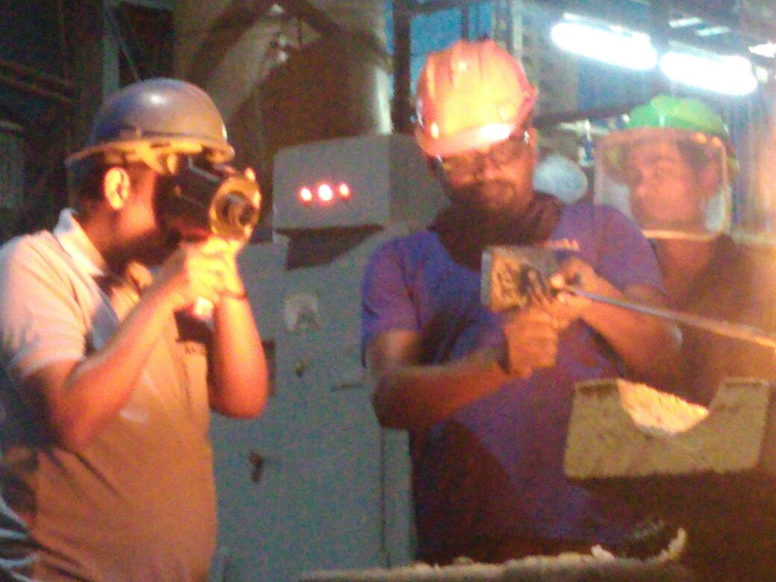
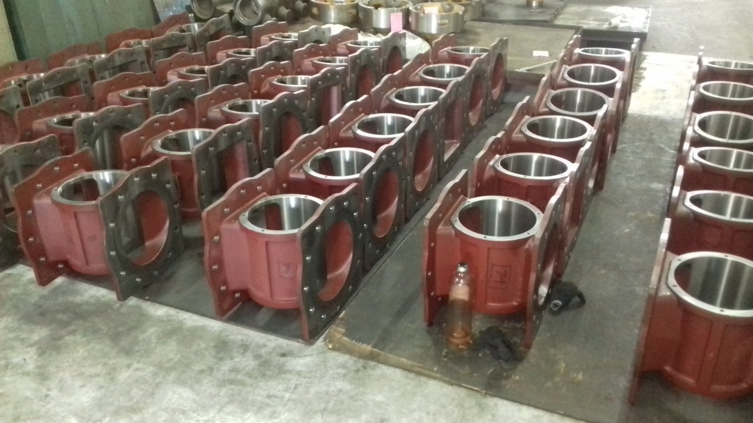
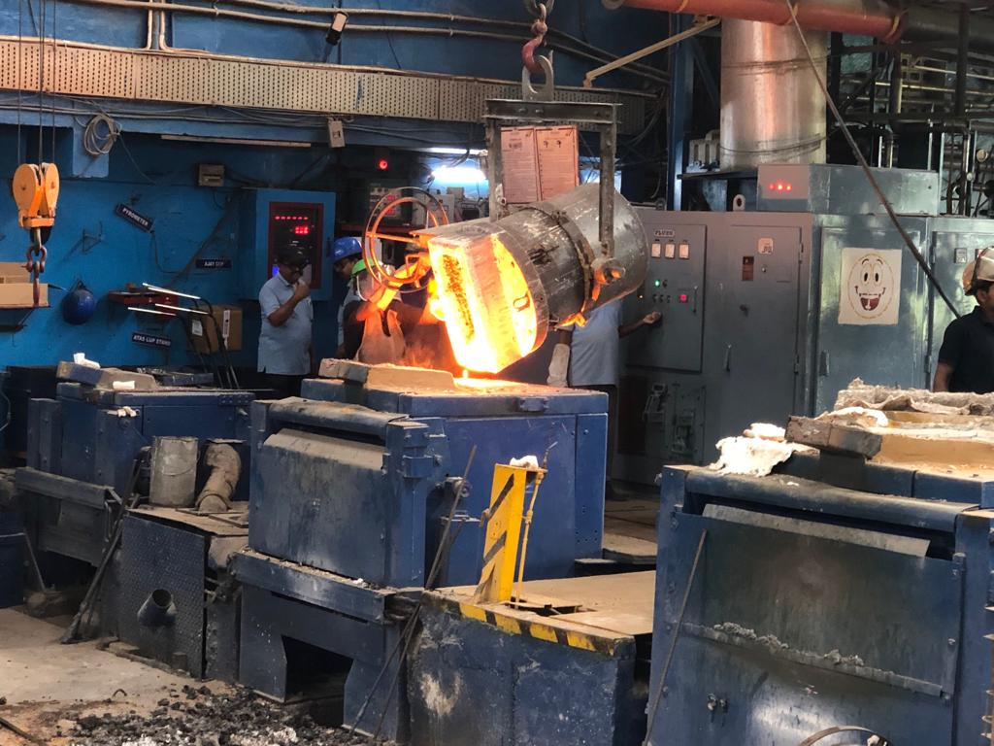
Team Akila Welcomes You

Slide 2
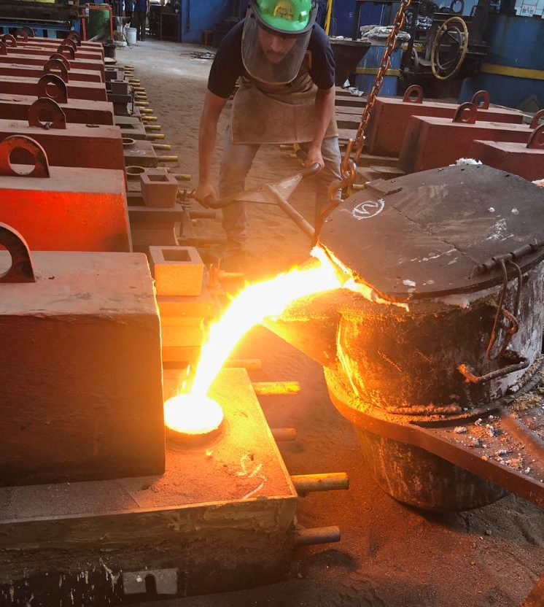
SRI AKILA CASTINGS
Founded 1974, focussed on manufacture of Iron castings
Located @ Chennai, South INDIA
Castings weight range from 0.3 Kgs to 5500 Kgs in Gray Iron & upto 2500 Kgs in Ductile Iron
Small to medium volumes – we process orders from
1No to batch quantities of a few hundreds

Slide 3
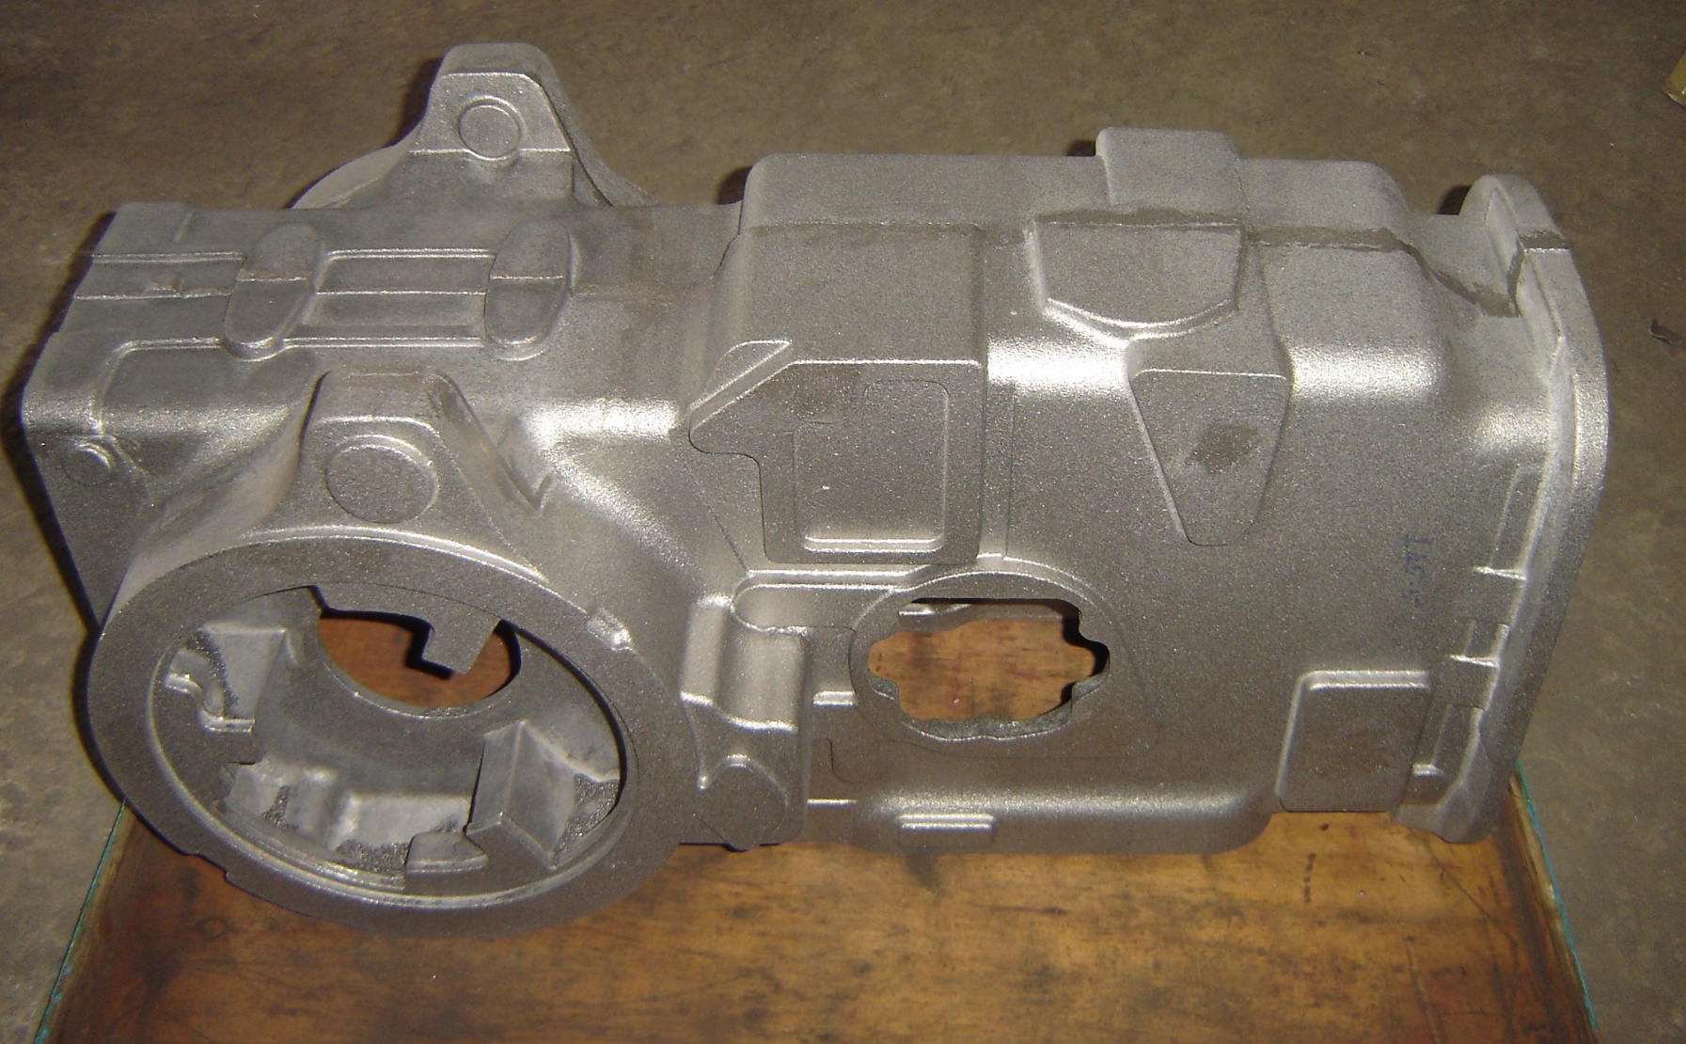
CAPABILITIES AND COMPETENCE
Flake Graphite and Nodular cast irons - alloyed and unalloyed
Sand castings of gray and ductile irons of the following types to radiographic/ultrasonic inspection standards:
Alloyed irons for special service conditions requiring resistance to abrasion, corrosion and high temperature.
Alloys with special compositions for application specific requirements such as SiMo,Ni-hard, Ni-resist, Abrasion resistant Chromium alloyed white irons
Casting weights range from 300 grams to 5500 Kgs single piece in gray cast iron and to 2500 Kgs single piece in ductile iron.

Slide 4
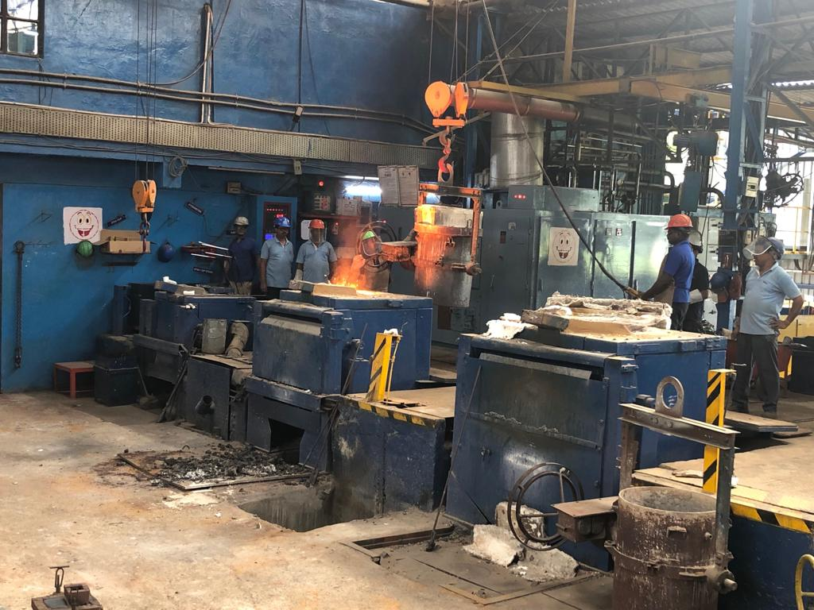
Moulding
Production PRocess ANd SYstems
Mould production using resin binders of the following types
* Gas cured resin binder system for cores (Ecolotec)
Liquid ester cured alkaline phenolic system for
moulds (Alphaset)
* Sand mixing by continuous mixer.
* Mould compaction with vibratory compaction tables.
Sand reclamation plant 6MT per hour
Melting
Induction melting – with control instrumentation for melt composition, temperature and weight of charge and liquid metal

Slide 5
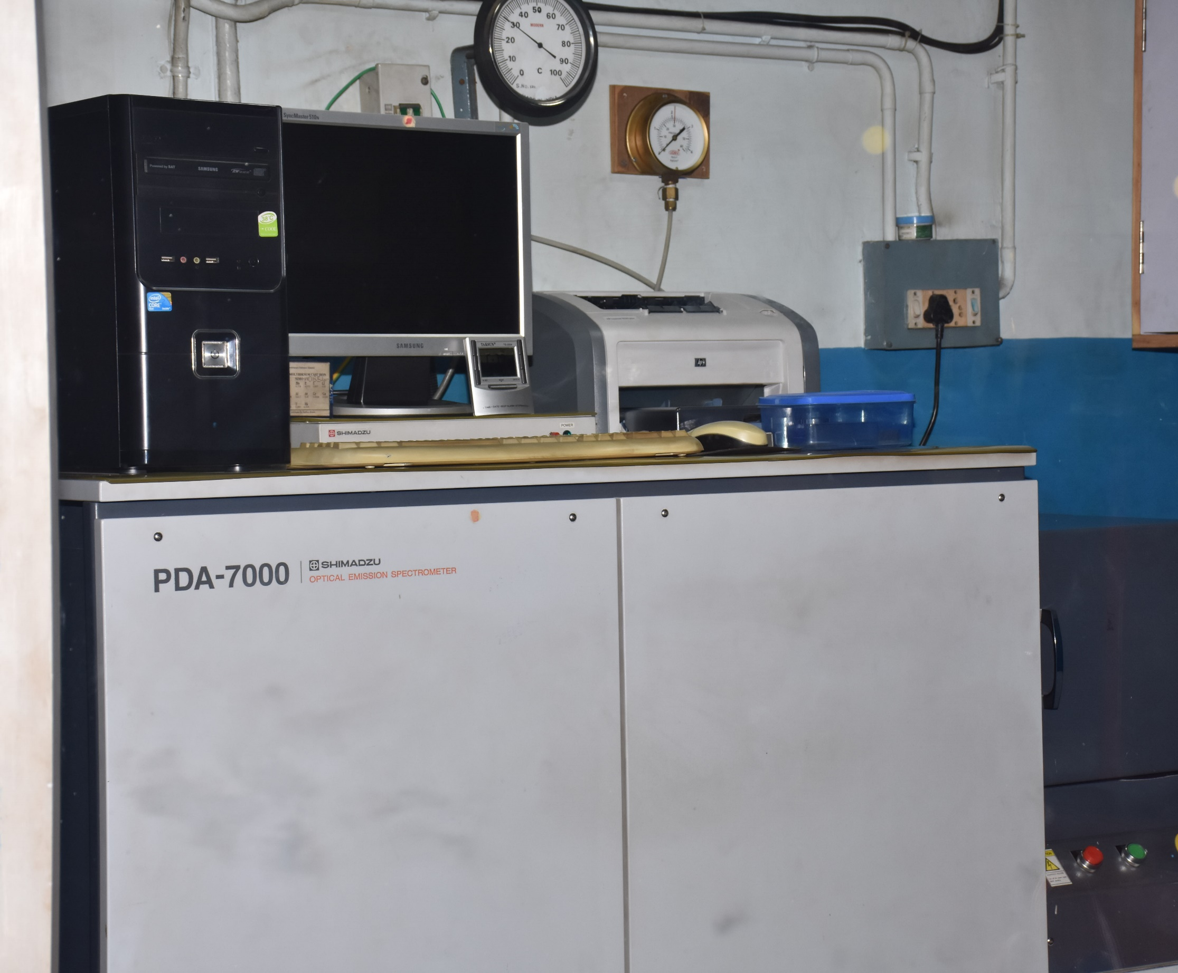
Process Control ANd Production
SYstems
Thermal Analysis and process control software – ATAS (Adaptive Thermal Analysis System), PQDIT (Prime Quality Ductile Iron Technology ) for online assessment and precise control of melt parameters
Spectrometer (OES) for composition analysis.
IronCad and NovaFlow & Solid – 3D part modeling and simulation of mould filling and solidification.

Slide 6
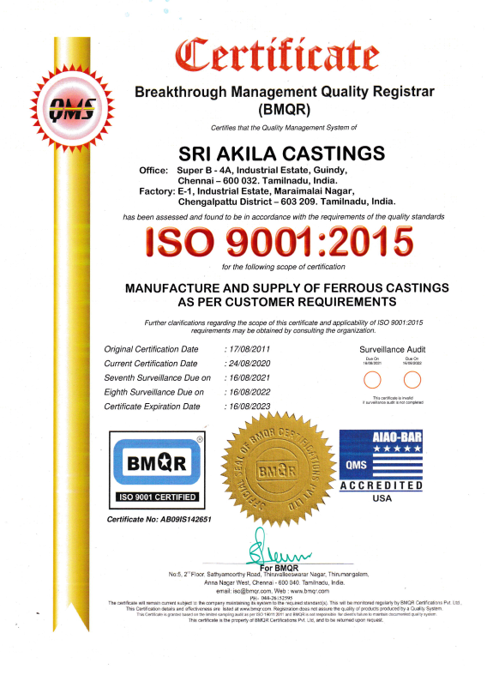
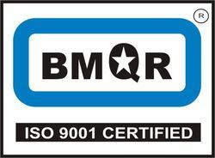
Certification - Quality Systems
Continued

Slide 7




PRofessional BOdies - MEmberships ANd AFfiliations
Institute of Indian Foundrymen (IIF)
American Foundry Society (AFS)
Ductile Iron Society (DIS)
Indian Institute of Technology, Chennai – ICSR

Slide 8
Typical Casting APPliCations
SiMo Grate bar castings for high temperature service and furnace castings for stokers - for renewable energy production
Machine tool bed castings, headstocks, saddles,rotary tables and related parts
Printing machine parts including impression cylinders
Construction equipment castings including cement pump parts and vibratory compactors
Jigs and Fixtures castings
Rotary airlock feeders and screw feeders
Crankcase & Crankshafts for refrigeration compressors
Castings for special purpose machines
Castings for Pumps and Valves

Slide 9
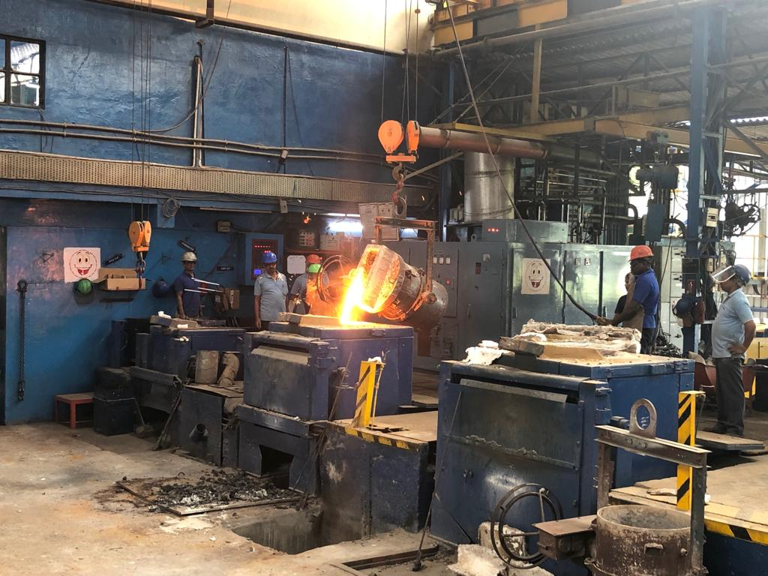
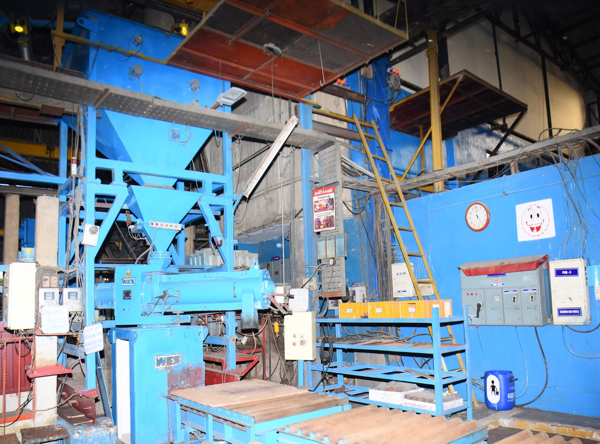
Infrastructure
Complete manufacturing facilities for manufacture of castings with the following production machineries, equipments and facilities.
Induction melting furnace, Medium Frequency power supply 750 KW with melting crucibles of 500 Kgs, 1000 Kgs and 2000 Kgs.
Continuous mixer 10 MT mixed resin sand per hour for two part resin system with compaction table for mould production.

Slide 10
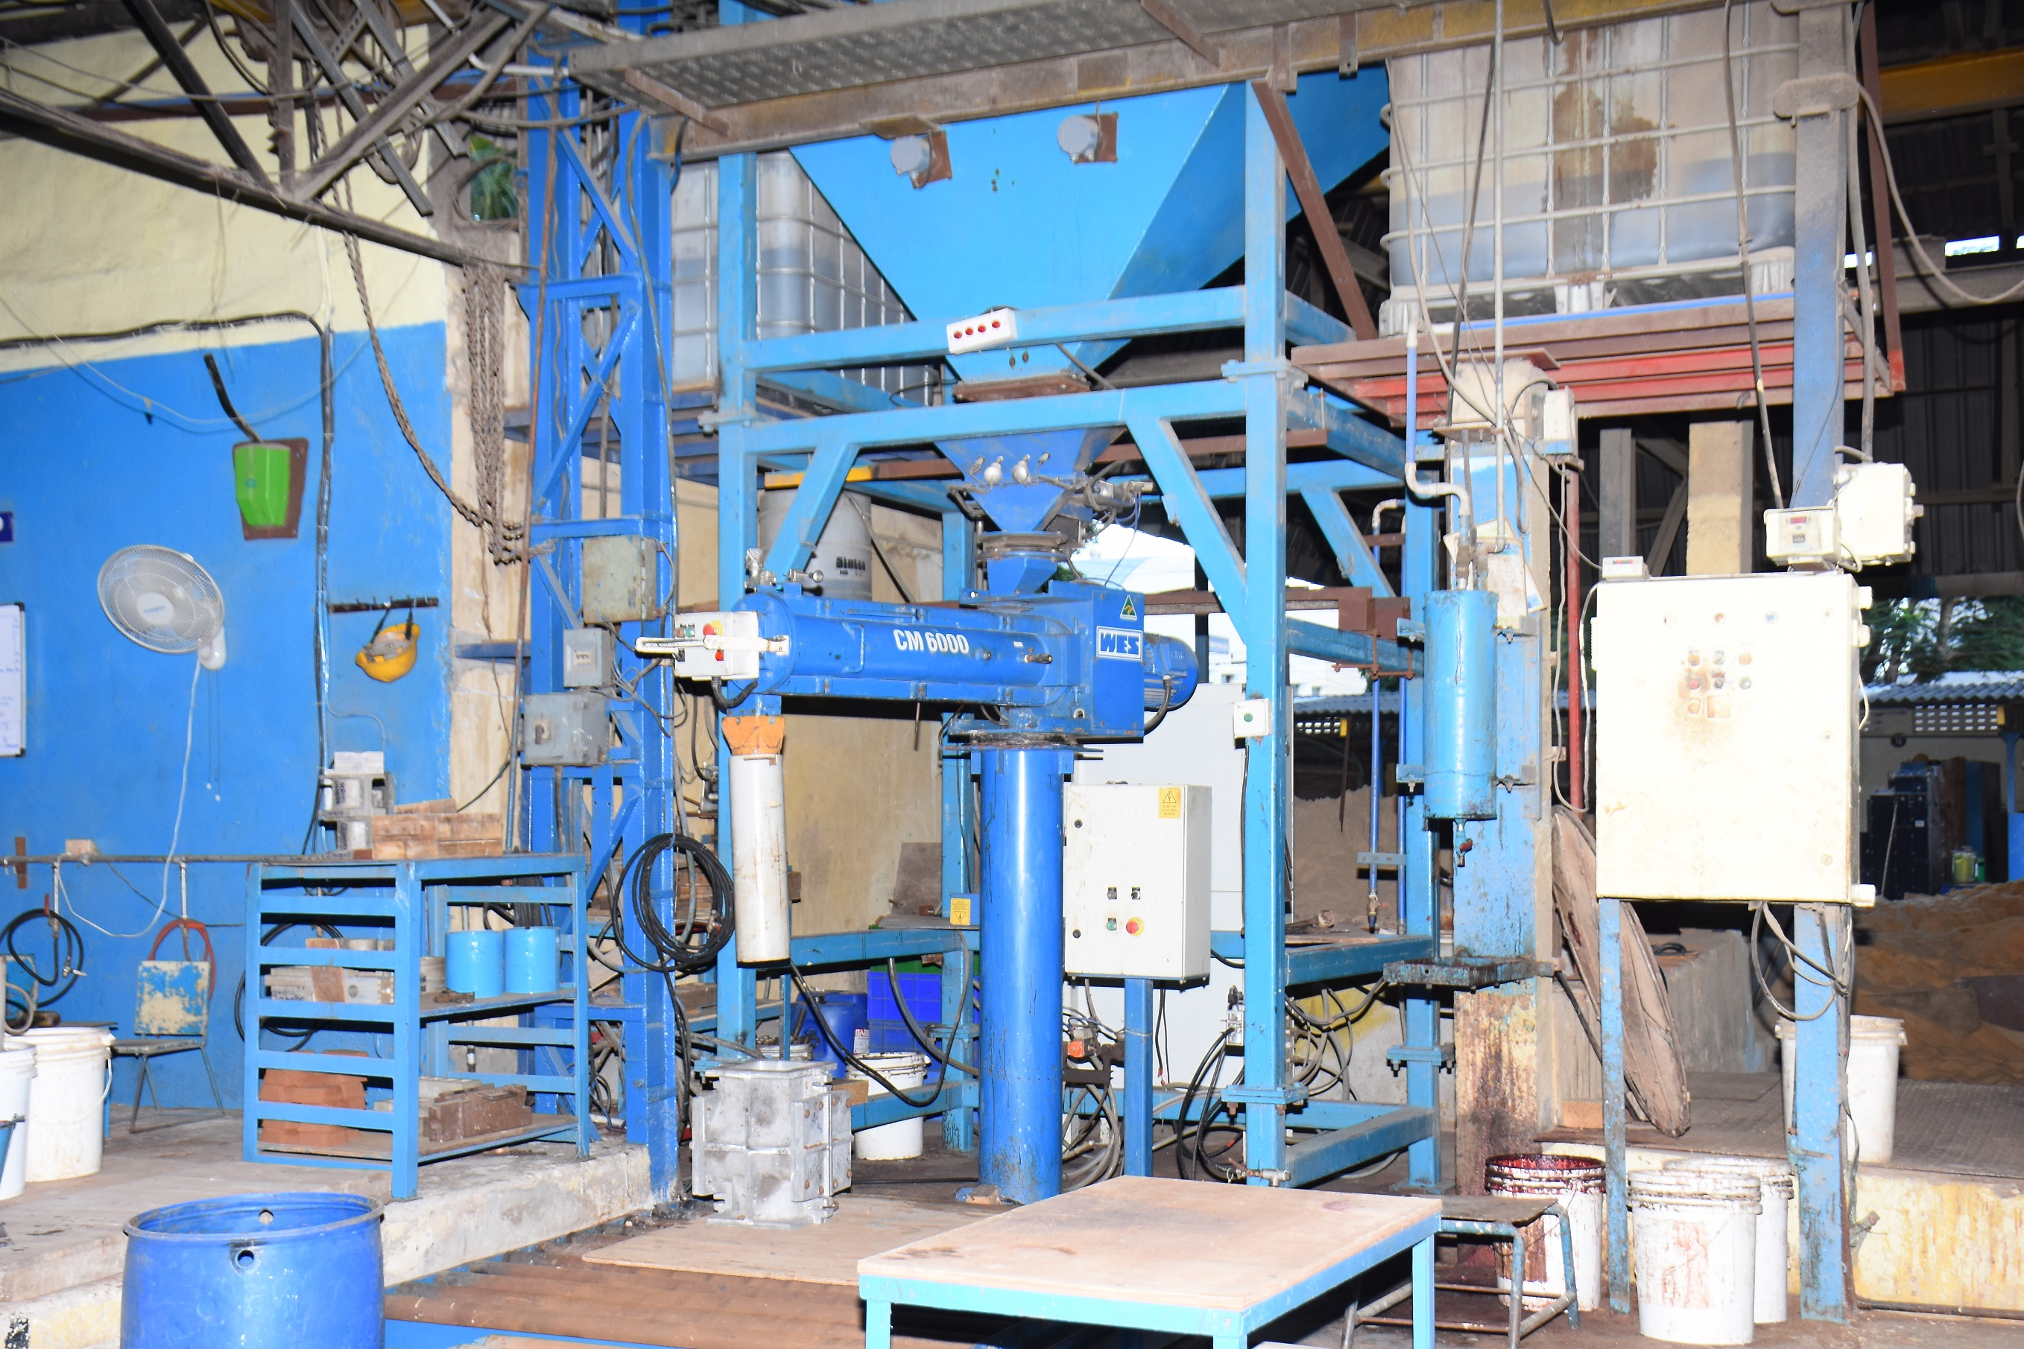
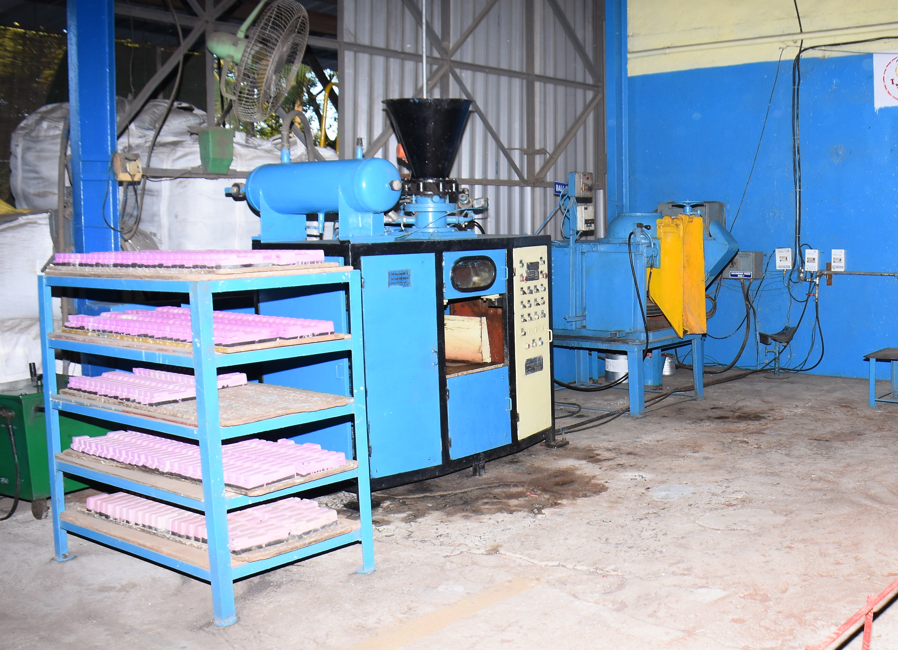
Infrastructure
Complete manufacturing facilities for manufacture of castings with the following production machineries, equipments and facilities.
Continuous mixer 6MT mixed sand per hour for core production.
Core Shooter for volume production of cores. Intensive batch mixer 150 Kgs capacity for core sand.

Slide 11
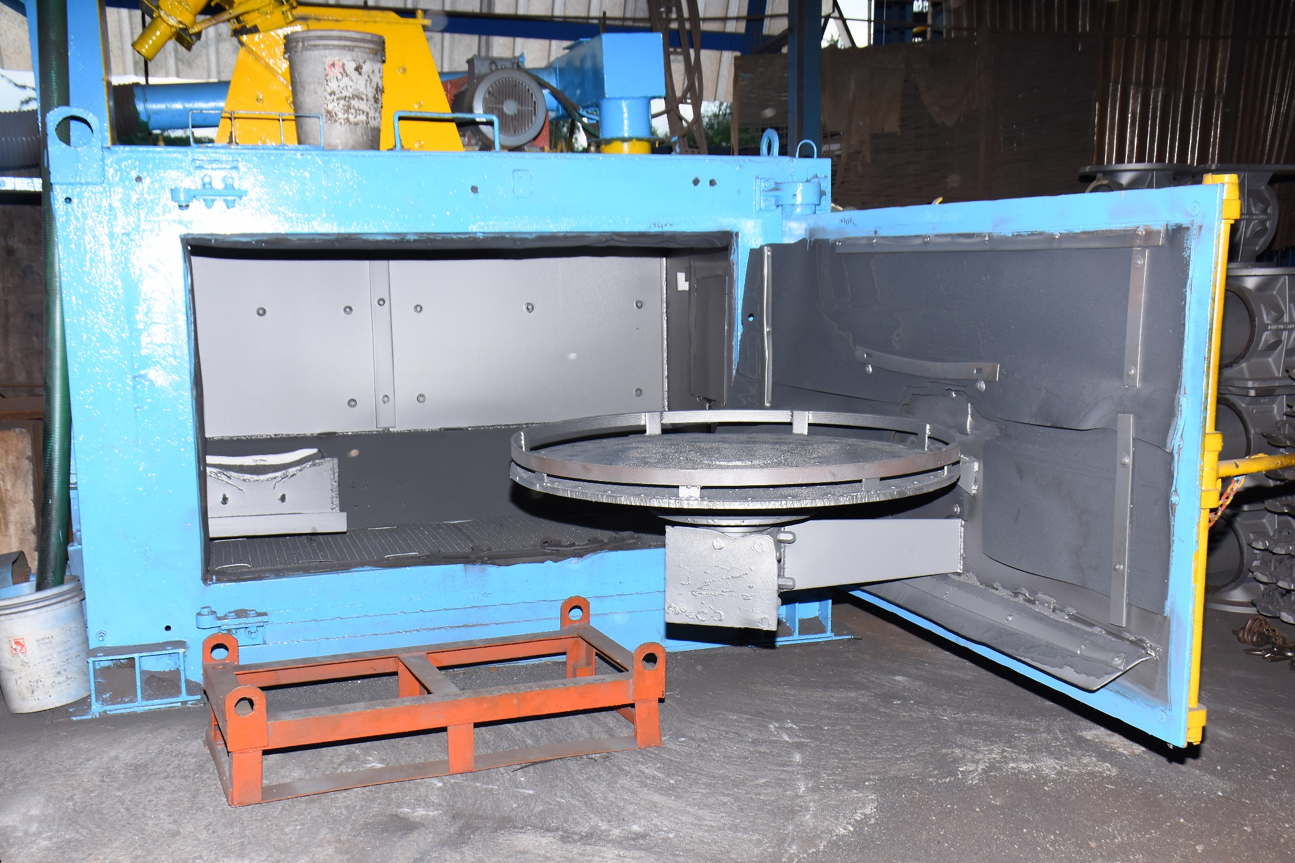
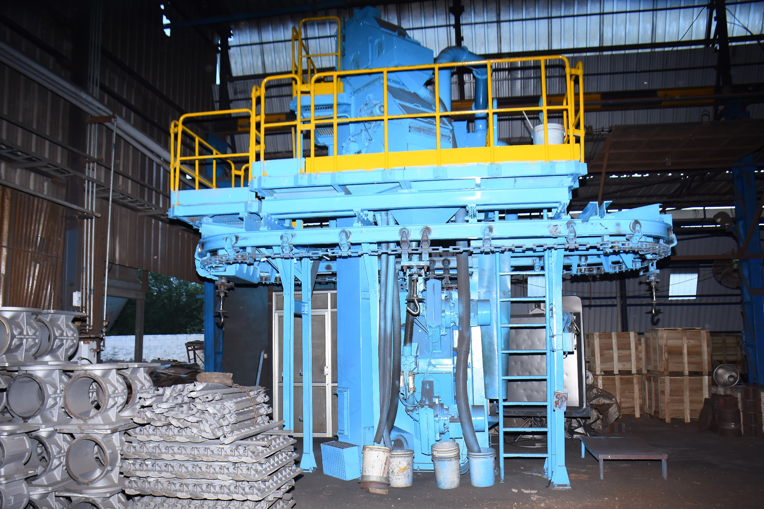
Infrastructure
Complete manufacturing facilities for manufacture of castings with the following production machineries, equipments and facilities.
Shot blast machine
* Table type
48” diameter table
Shot blast machine
* Spinner Hanger type
750 Kgs Hook Capacity

Slide 12
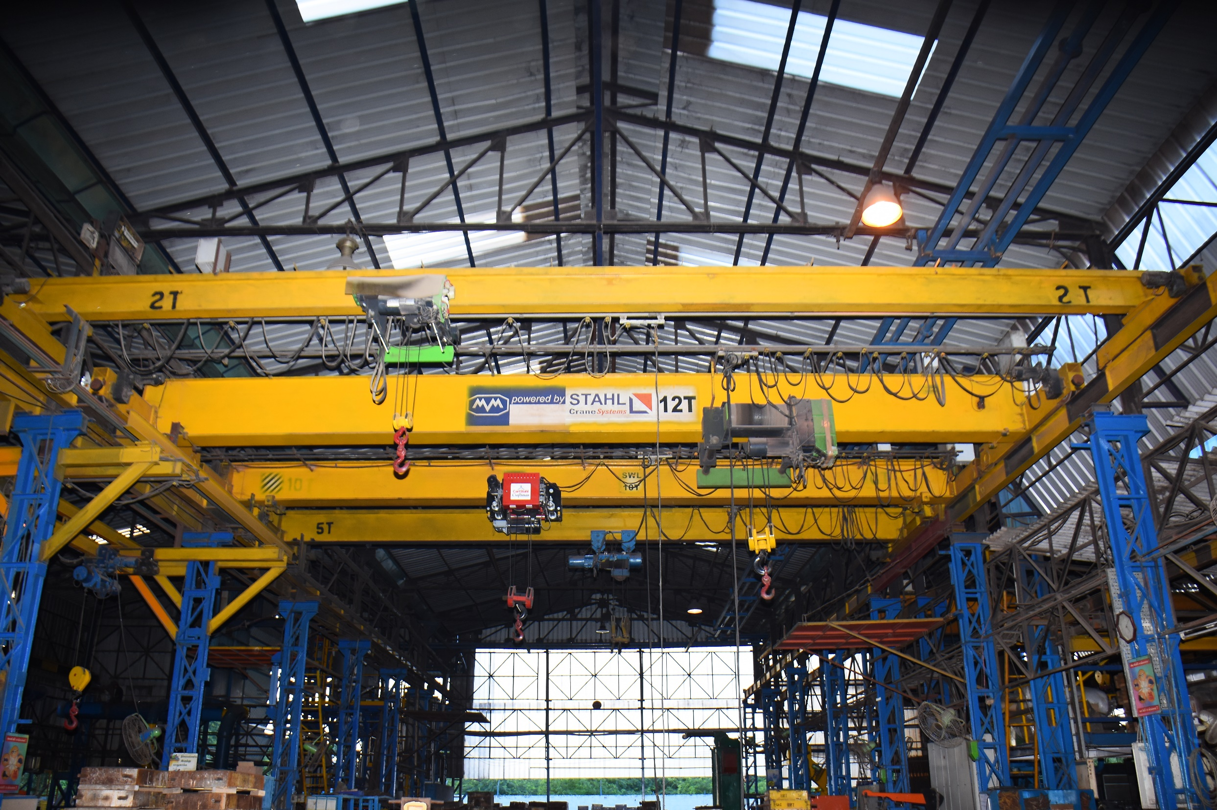
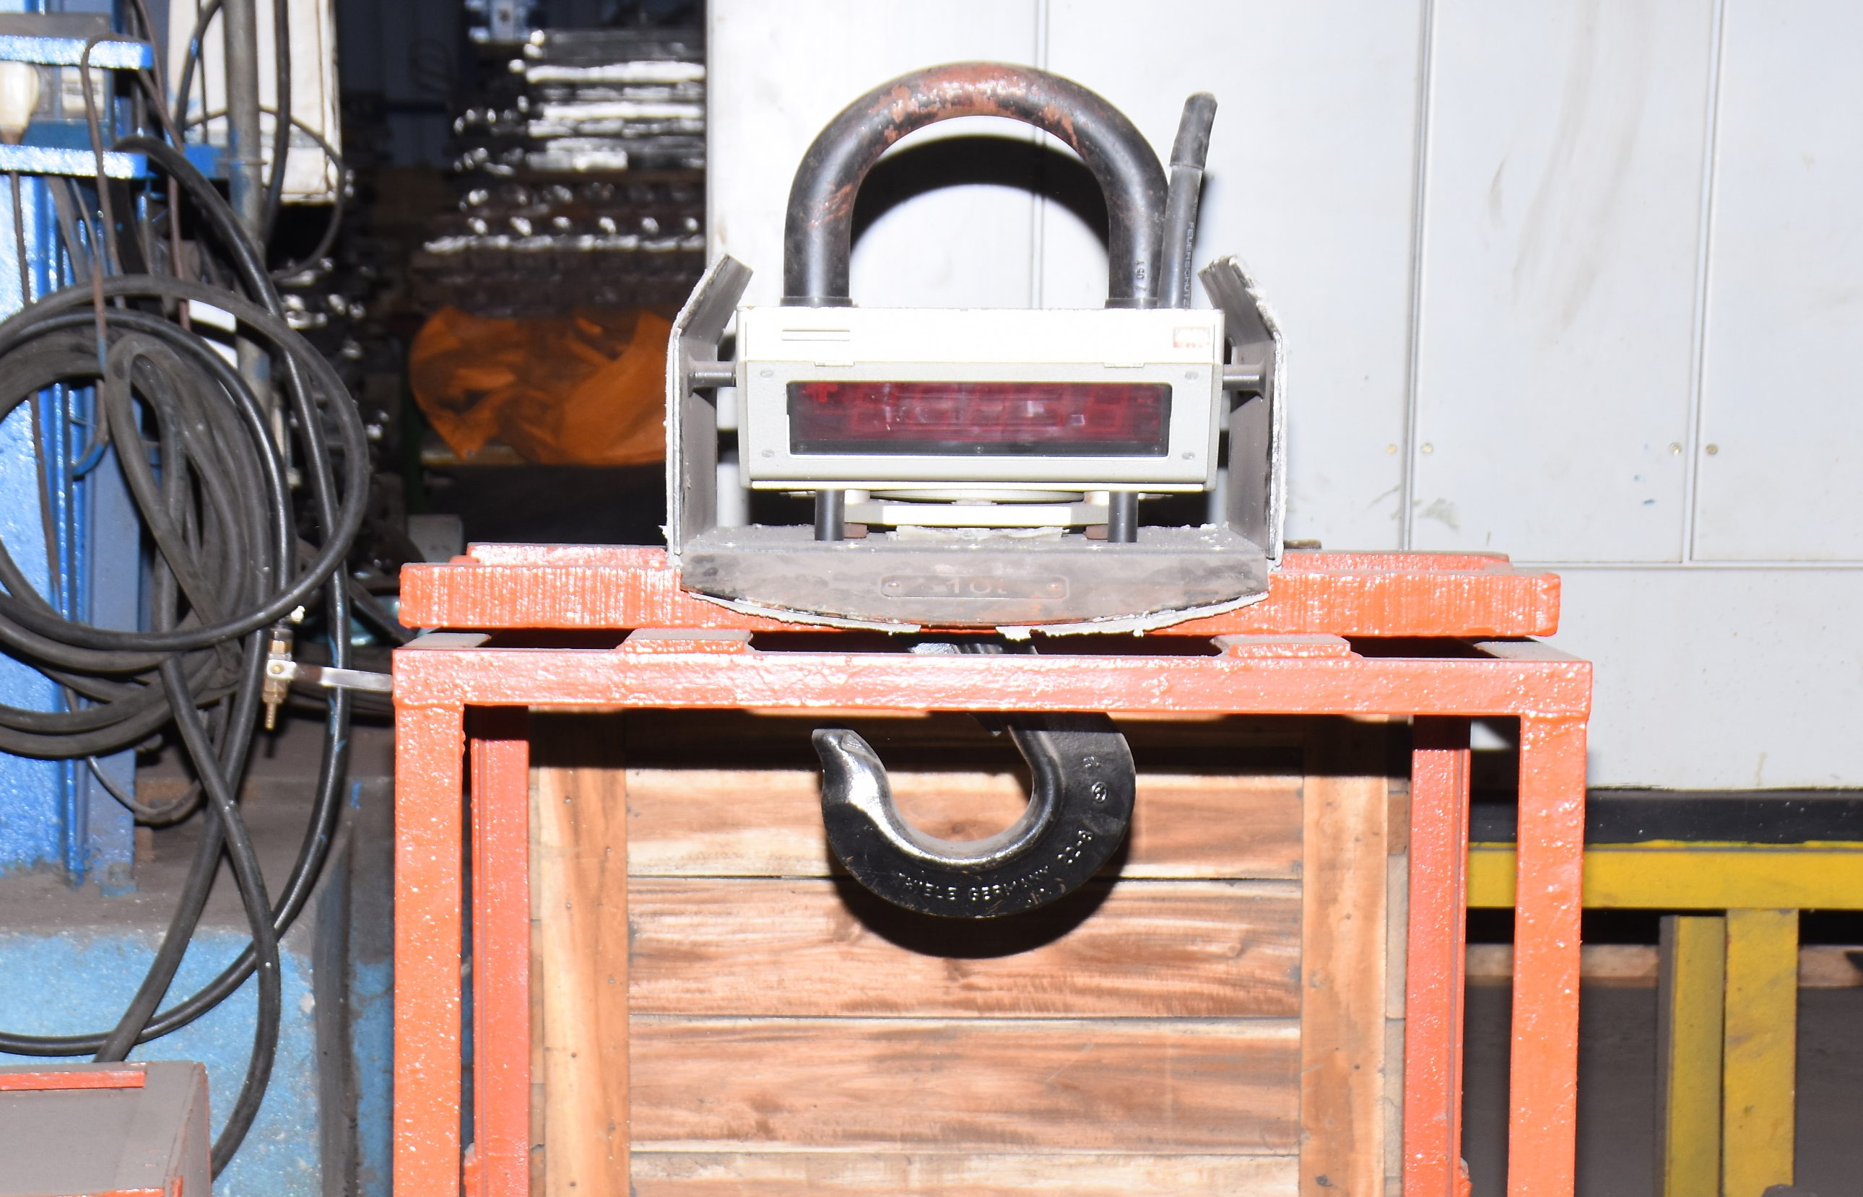
Infrastructure
Complete manufacturing facilities for manufacture of castings with the following production machineries, equipments and facilities.
EOT cranes of capacity 12.5 MT, 10 MT, 5Mt and 2MT for handling hot metal and large moulds.
Digital crane weigher 10 MT capacity for precise weighment of molten metal during filling and pouring with wireless data transfer facility for recording data.

Slide 13
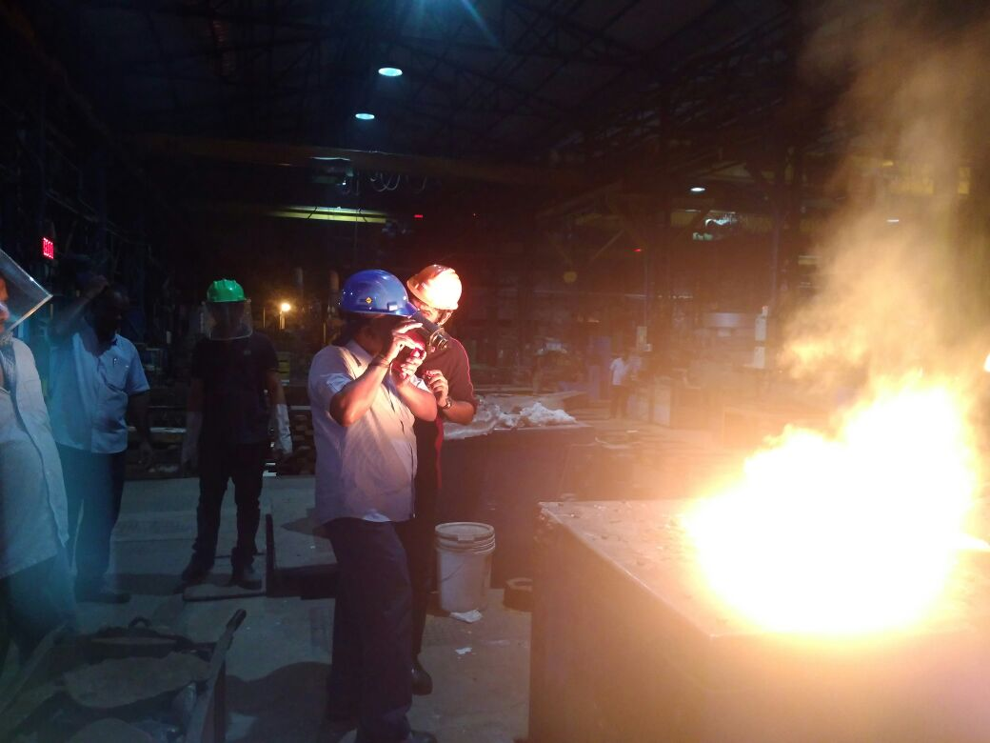
Infrastructure
Complete manufacturing facilities for manufacture of castings with the following production machineries, equipments and facilities.
Process control instrumentation and temperature measurement capability - including microprocessor based thermal analysis instruments and immersion pyrometers for liquid metal temperature measurement.
ATAS - metallurgical process control software from Novacast for precise assessment of melt condition and control of melt parameters prior to pouring with prediction of tensile, hardness and cell counts.

Slide 14
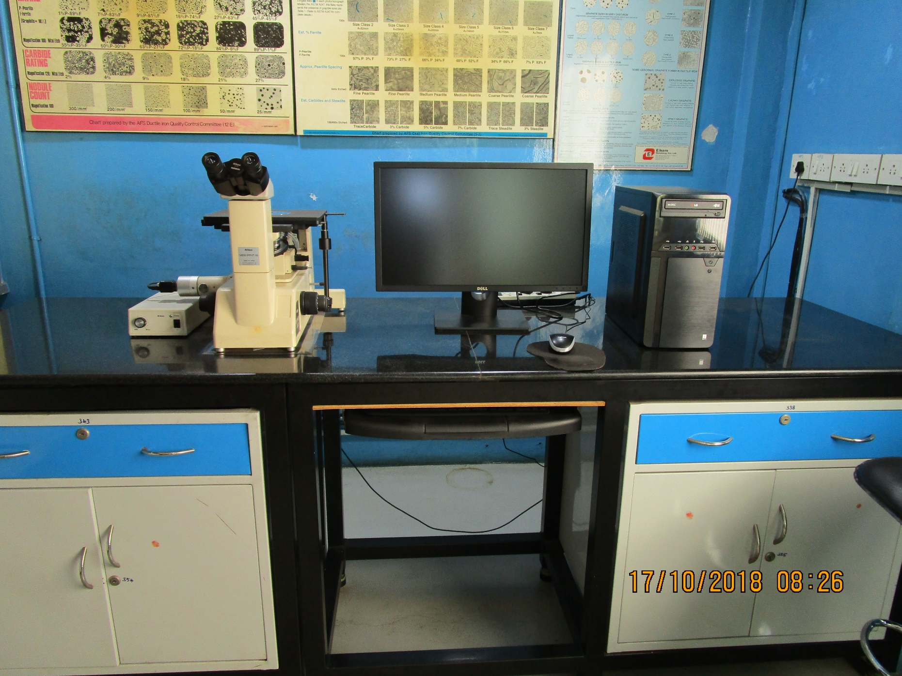
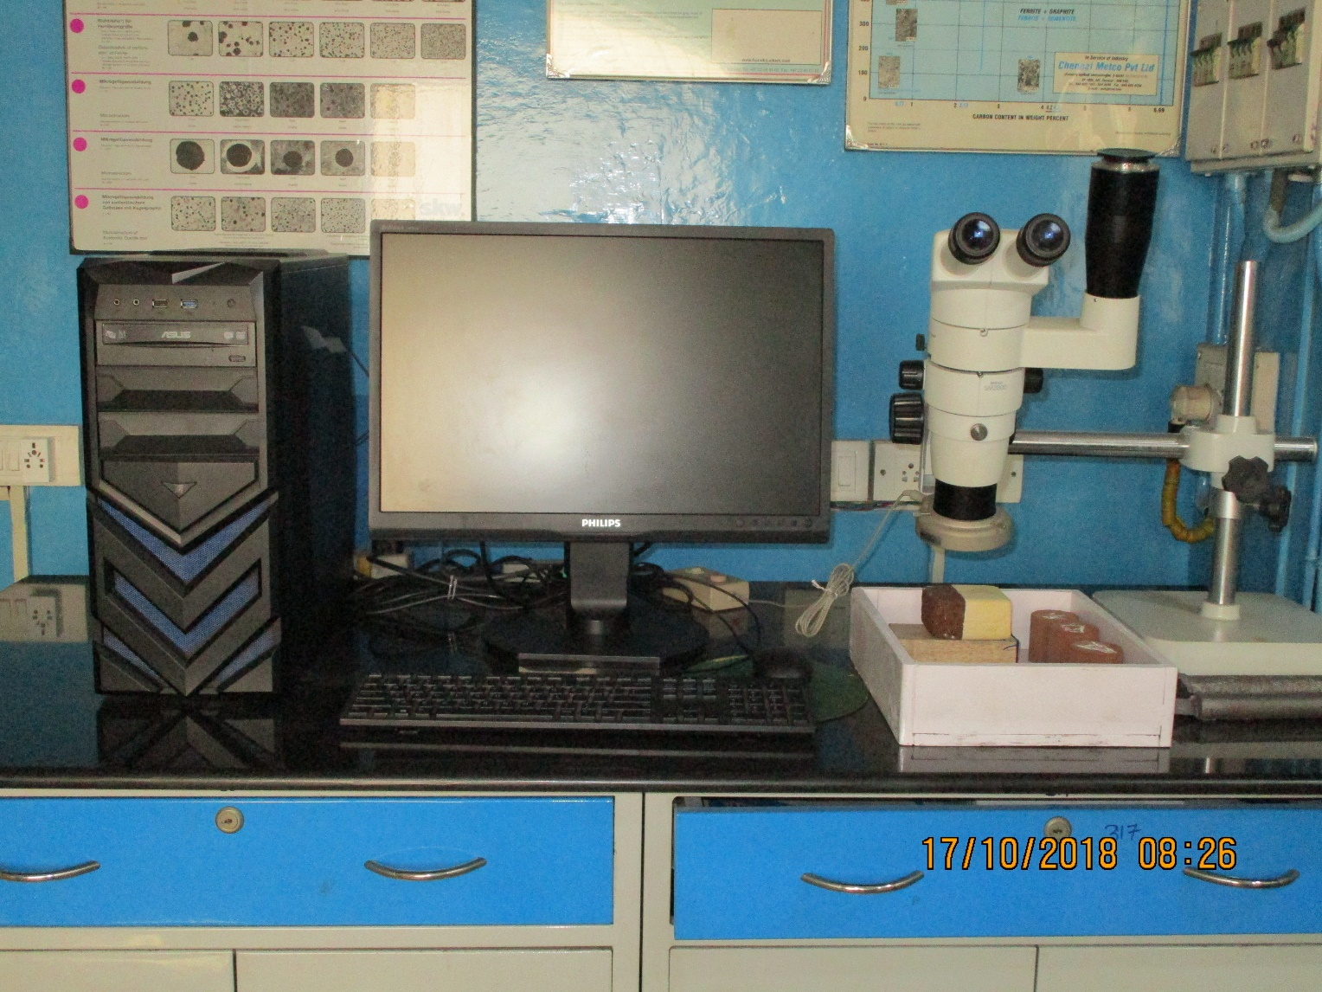
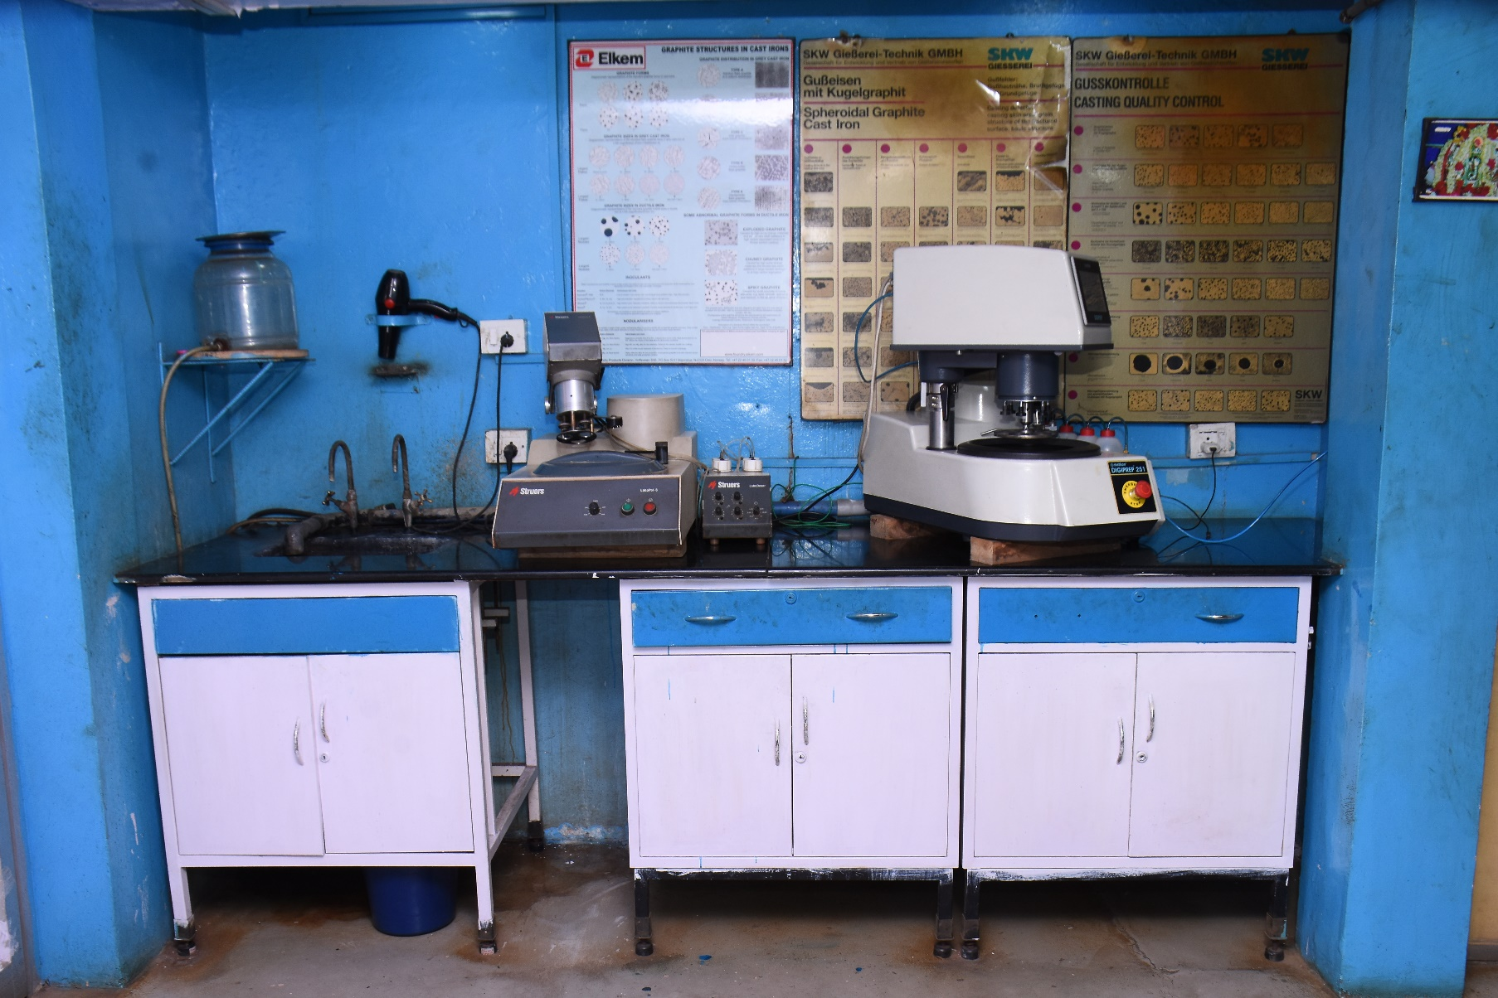
Infrastructure
Continued
Clemex Image analyser Vision PE - for microstructure image capture and quantification of alloy phases with report generation including microstructure photos.
Simulation software: Novaflow & Solid for PC based casting solidification simulation to determine optimum locations for placement of in-gates and feeders and determining geometric points prone to defects such as shrinkage and porosity.
Nikon microscope with camera – Epiphot 200 – capable of sample evaluation by bright field (BF), darkfield (DF), polarised light (Pol) and differential interference contrast (DIC).
Nikon stereo zoom microscope – for study of casting defects and evaluation of sand grains and surface finish of moulds and cores.
Struers automatic polisher for preparation of microstructure specimens for optical microscopy and image analysis.

Slide 15
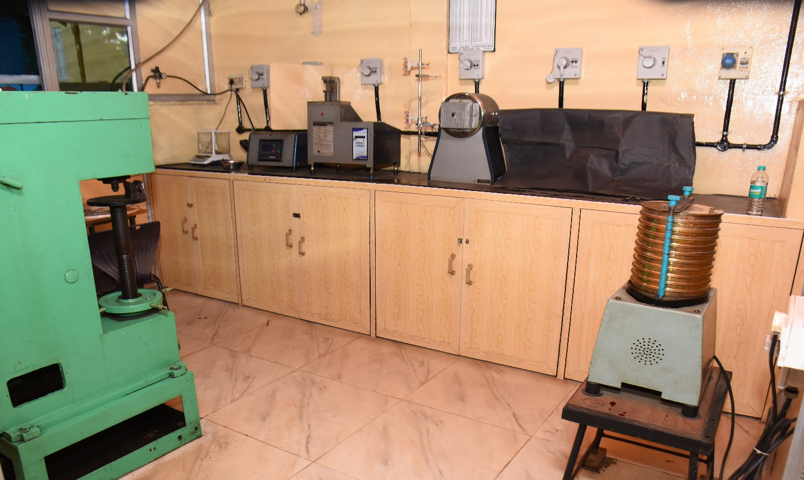
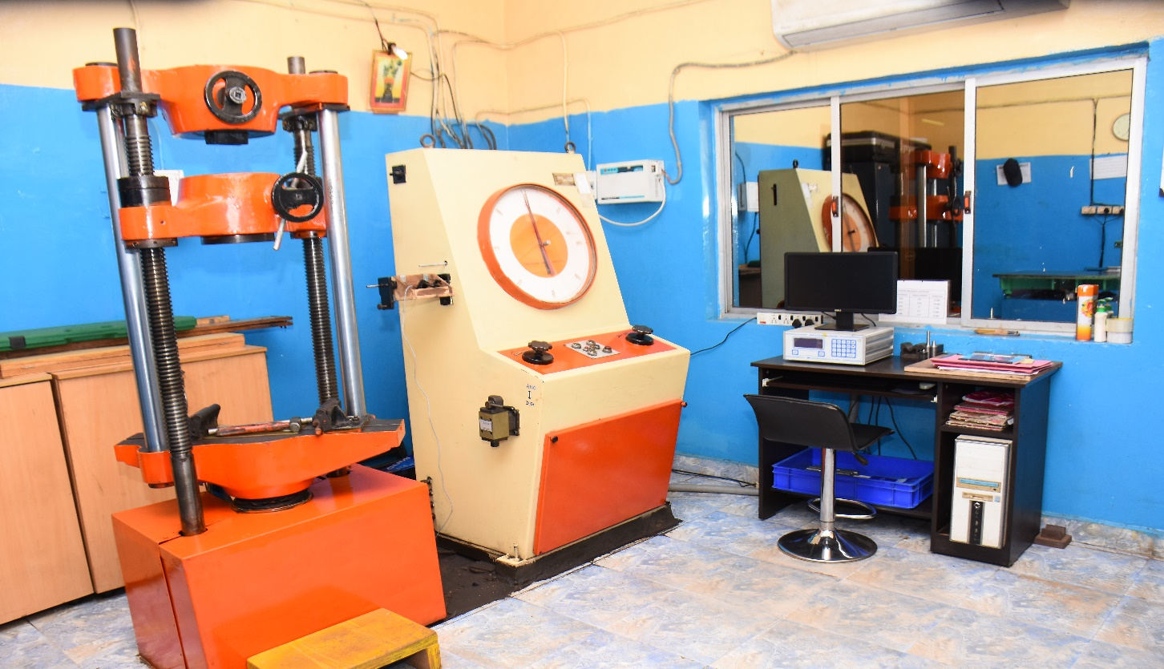
Infrastructure
Foundry working area of 1600 square meters in three bays with material handling facilities
Continued
Sand laboratory for testing of moulding sands – bonded and unbonded.
Outsourced facilities for pattern making, heat treatment and NDT inspection including Ultrasonic and Radiography.
CAD Software IRONCAD for 3D modeling and drafting
Mechanical testing of physical properties - 40 ton UTM for tensile testing and hardness tester 3000 Kgs load with 10 mm dia indentation ball and portable hardness tester for hardness measurement of large castings
Standby generators of capacity 1010, 250 and 63 KVA
Primer & Rust preventive coatings by spray & dipping.
Inspection instruments and gauges for precise measurement up to one meter.
Molten metal handling ladles of capacities from 80 Kgs to 5 tons for handling hot metal.
Grinding and fettling facility with power operated hand tools.

Slide 16

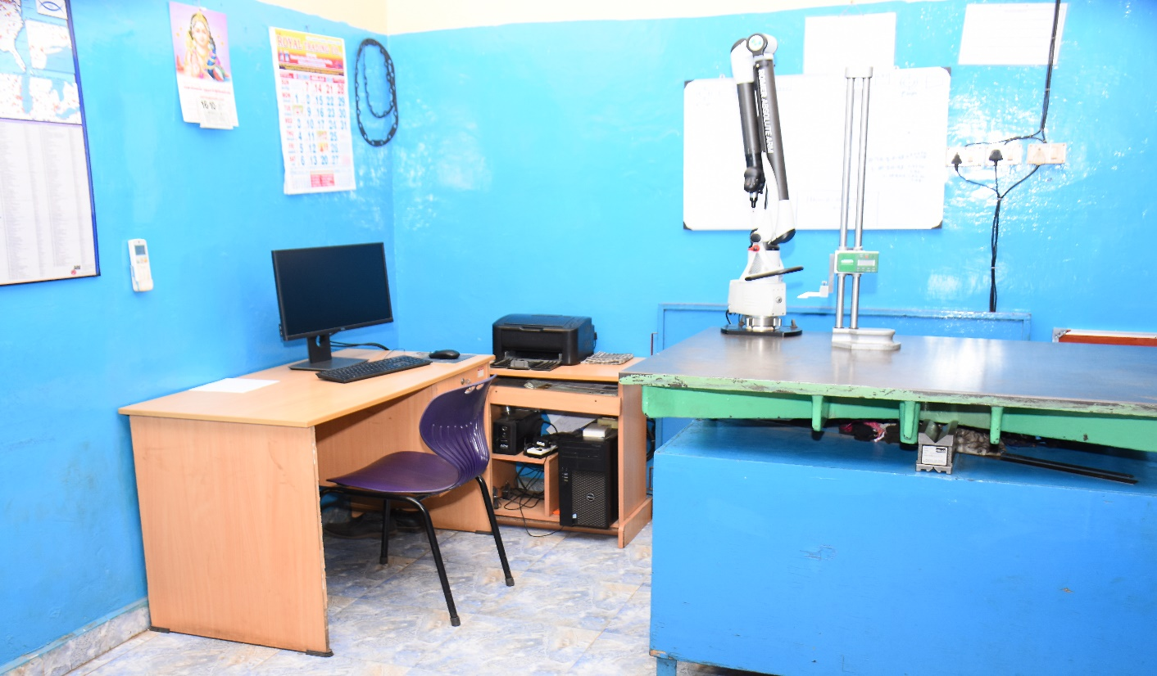



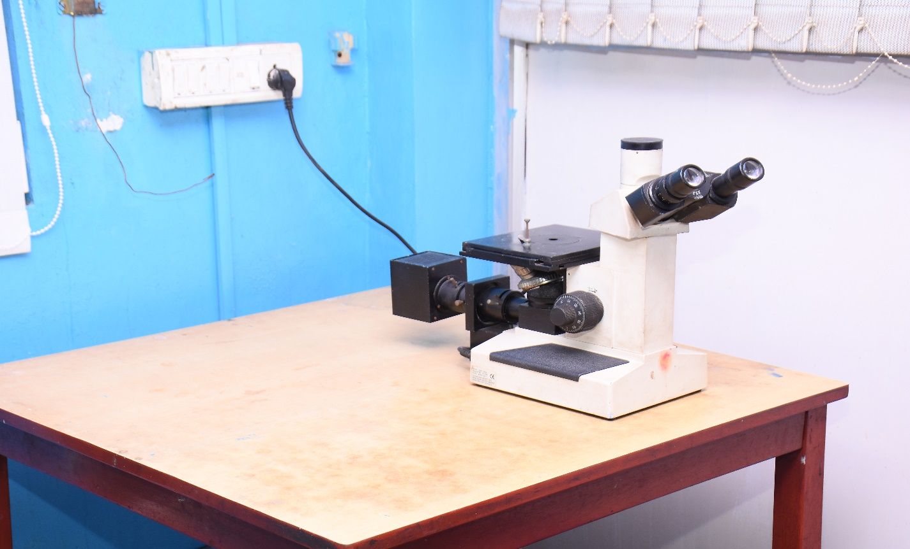
Infrastructure
Continued

Slide 17
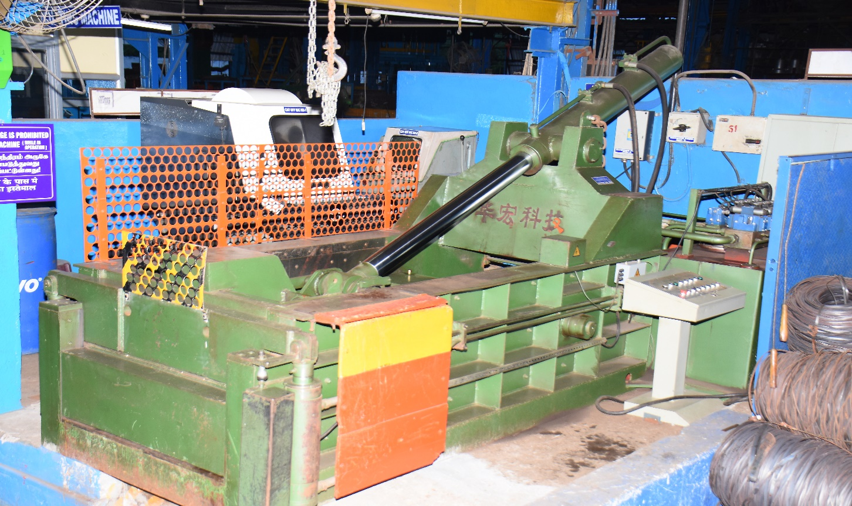
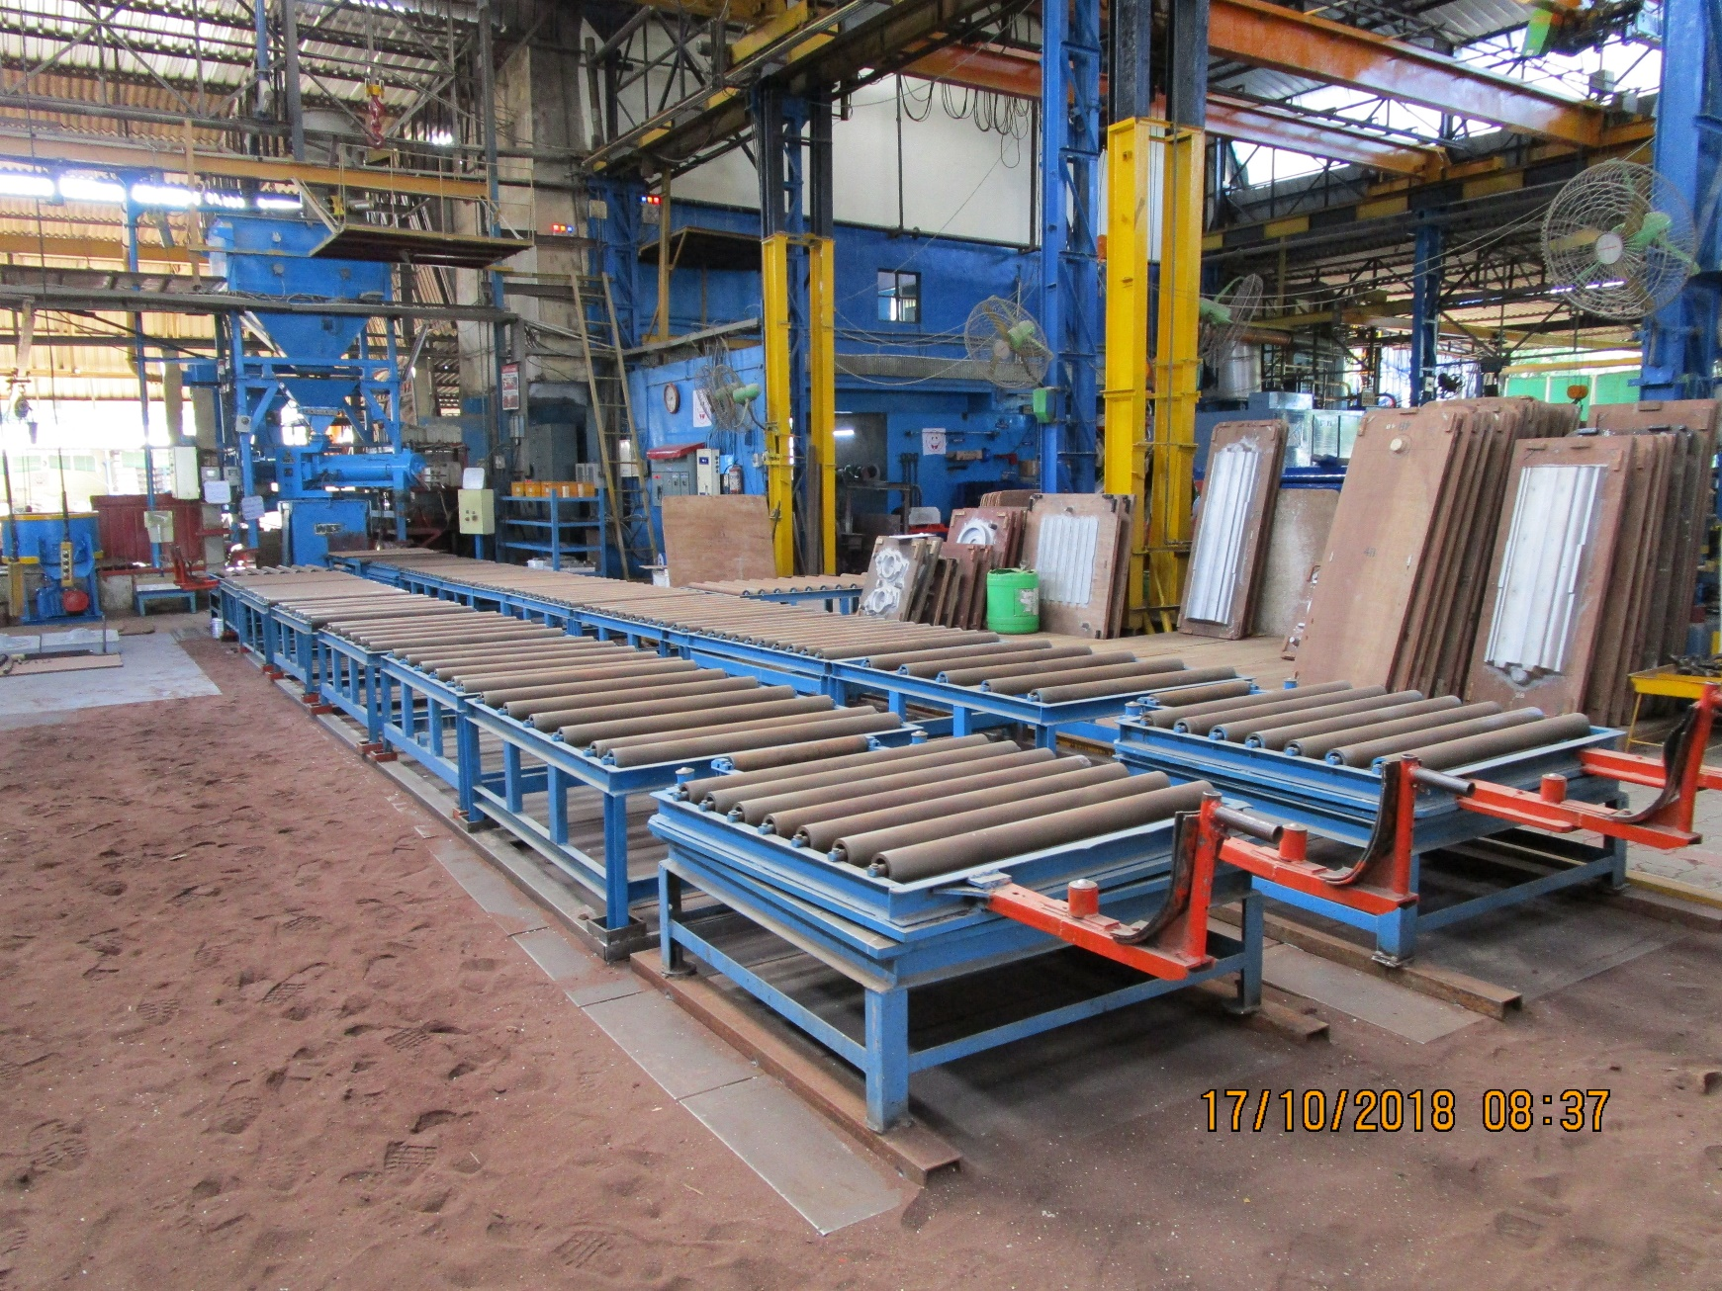
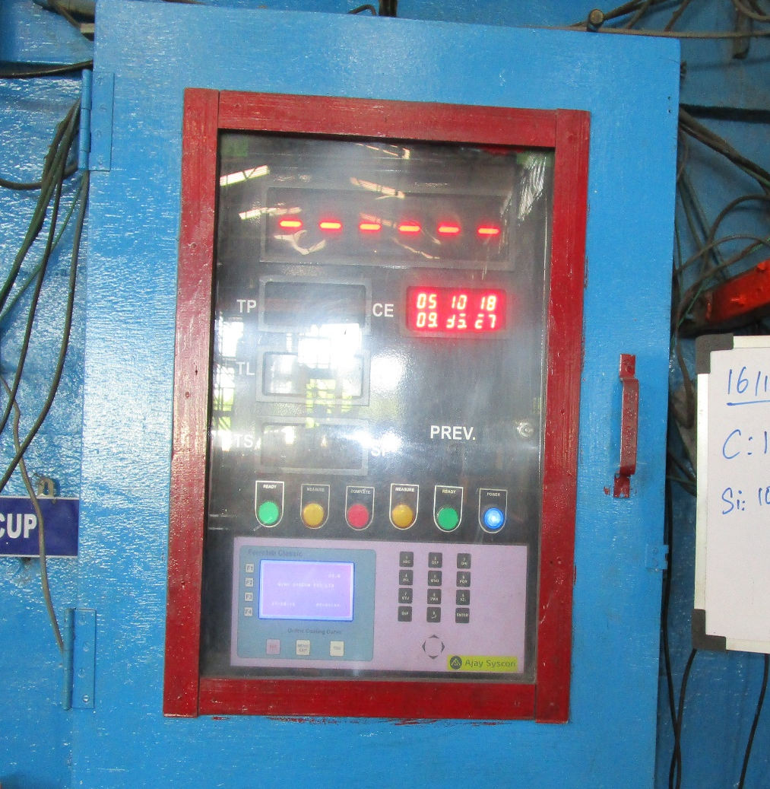
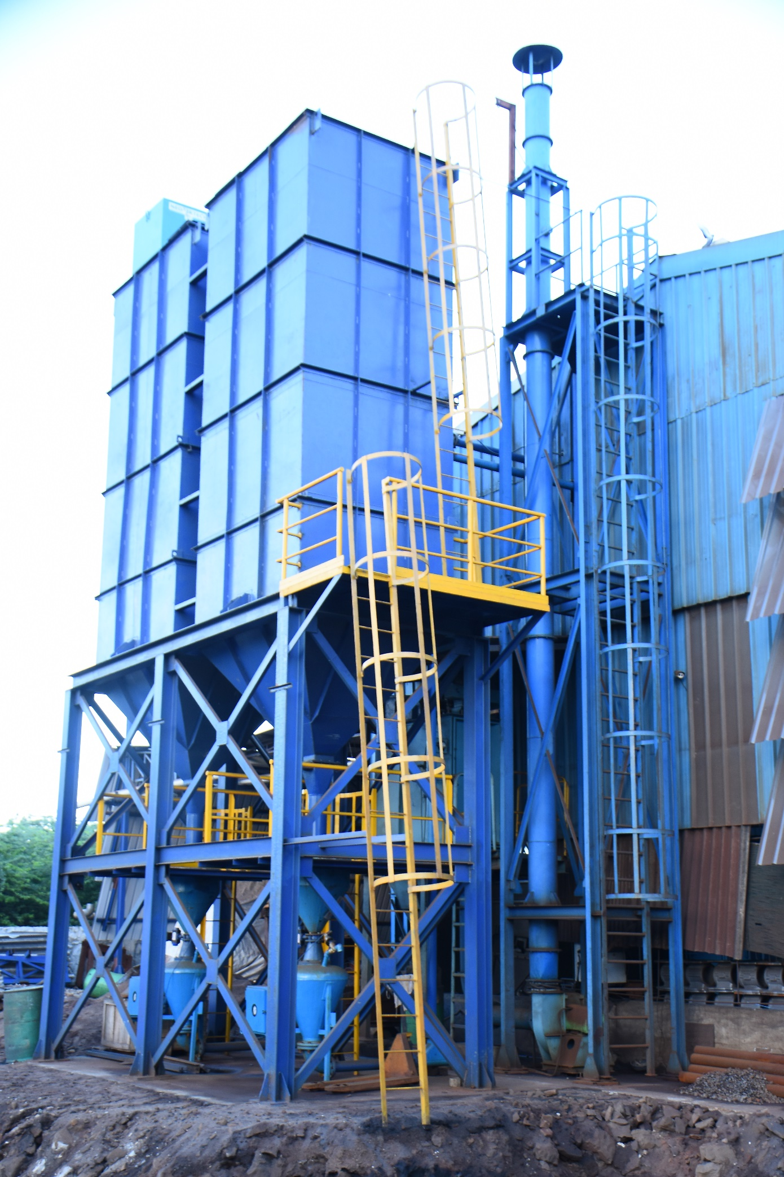
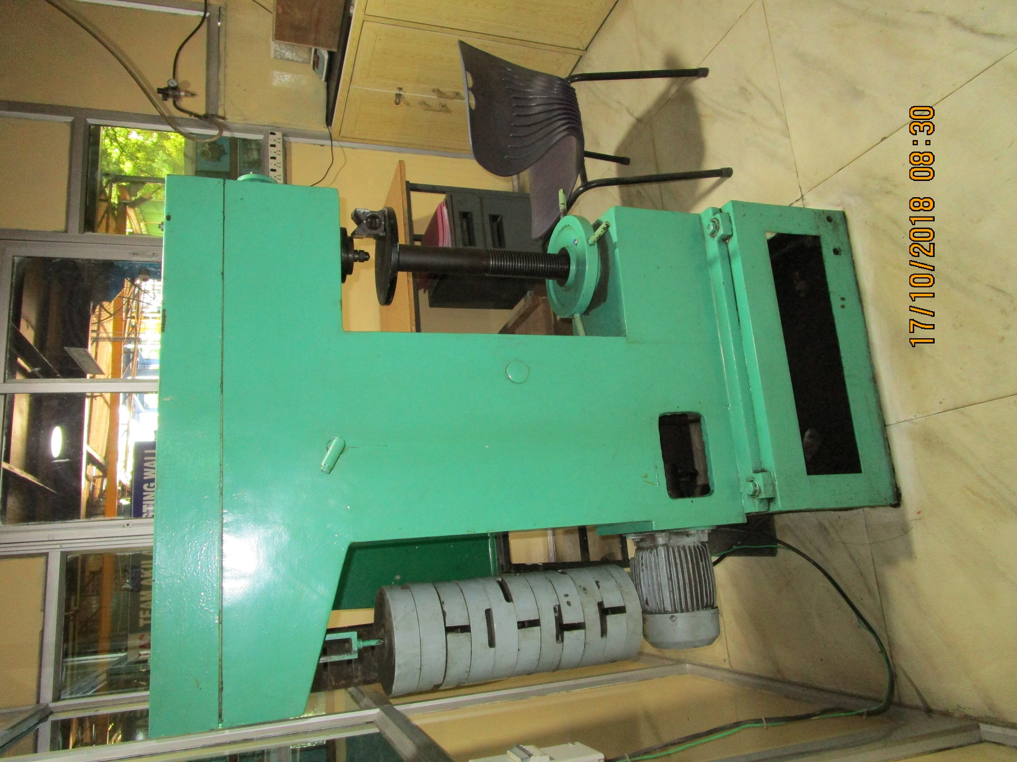
Infrastructure
Continued

Slide 18
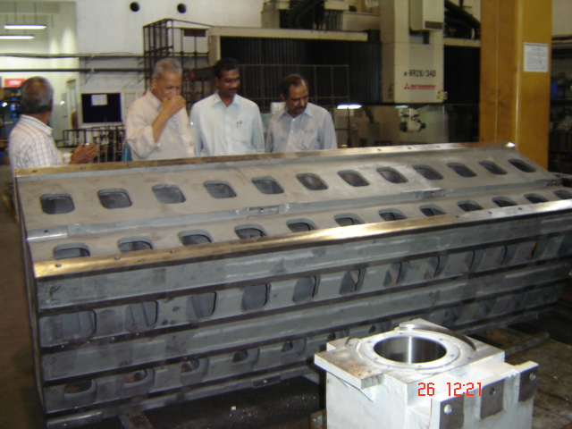
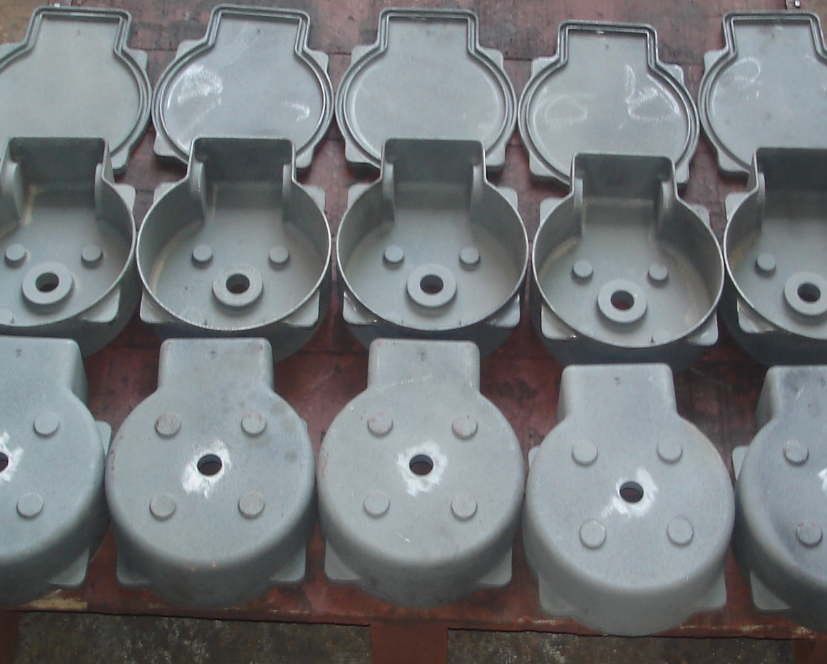
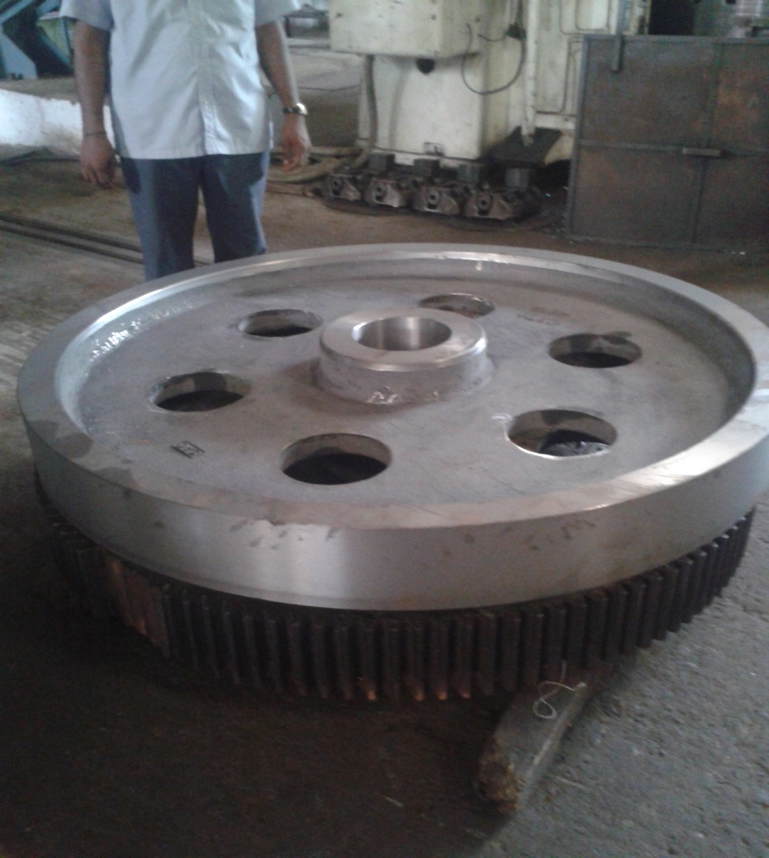
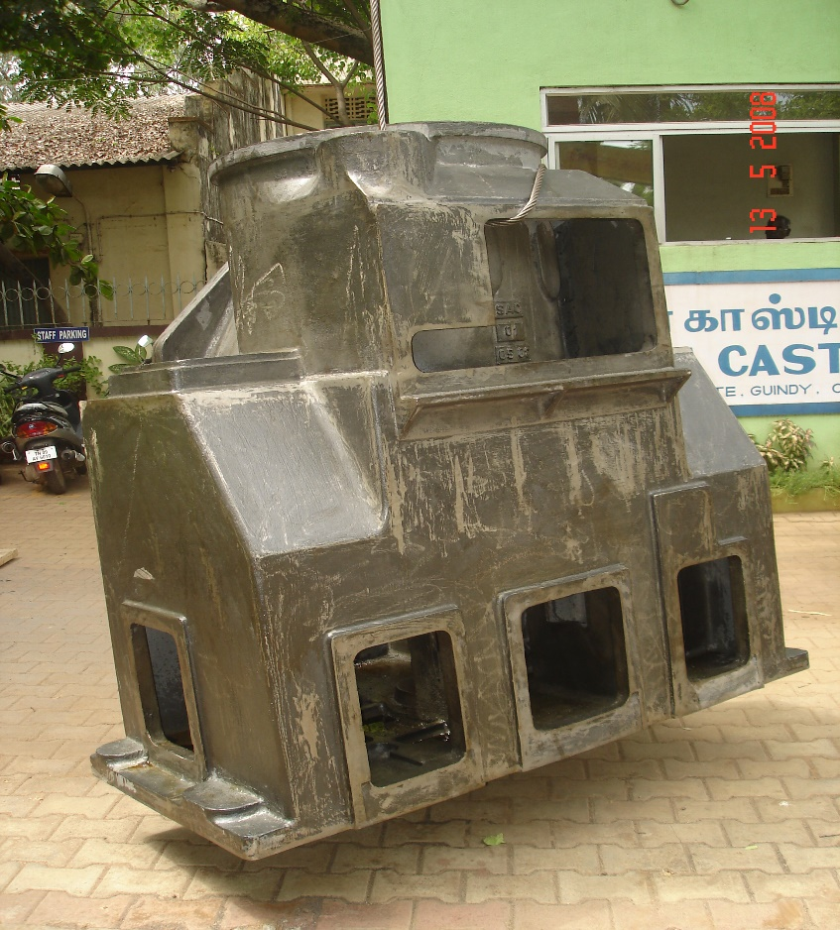
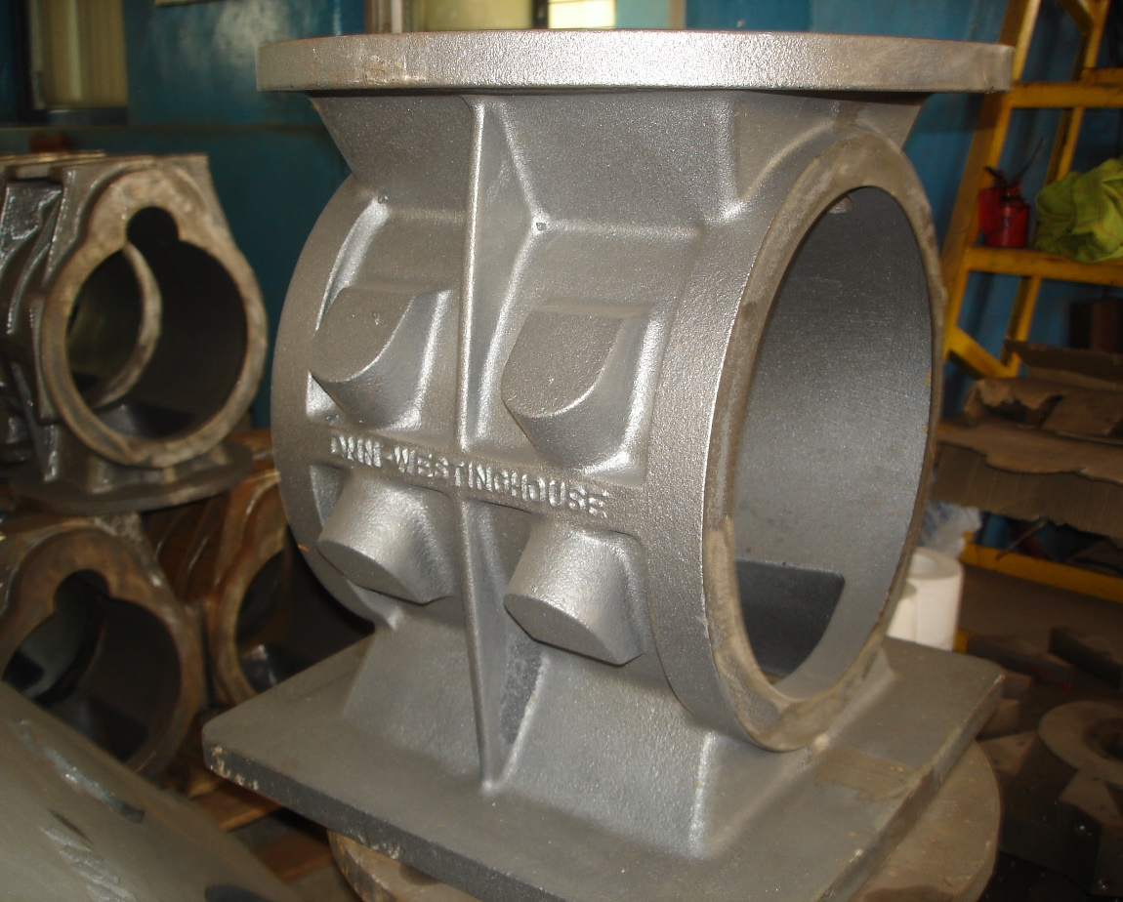
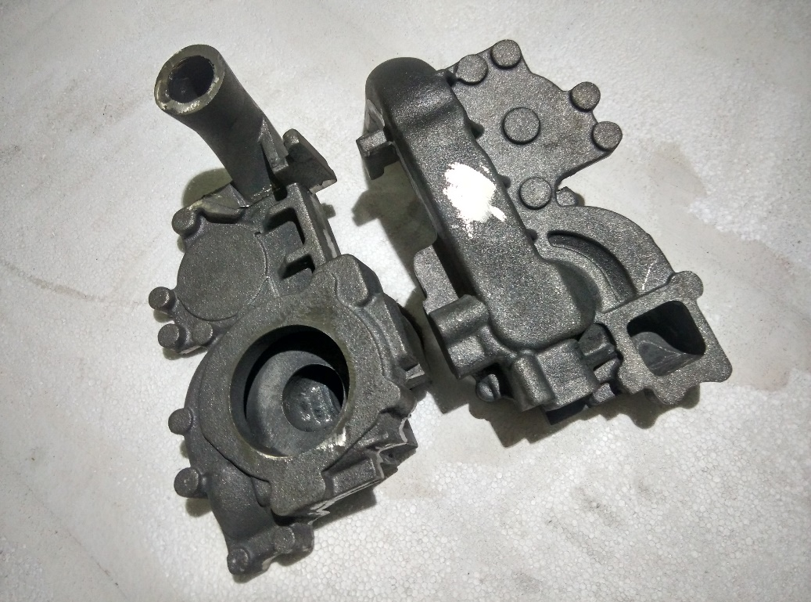
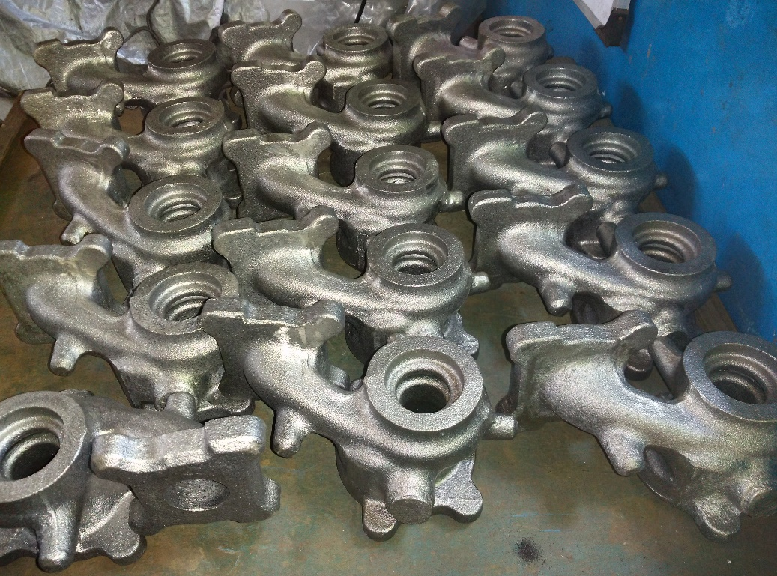
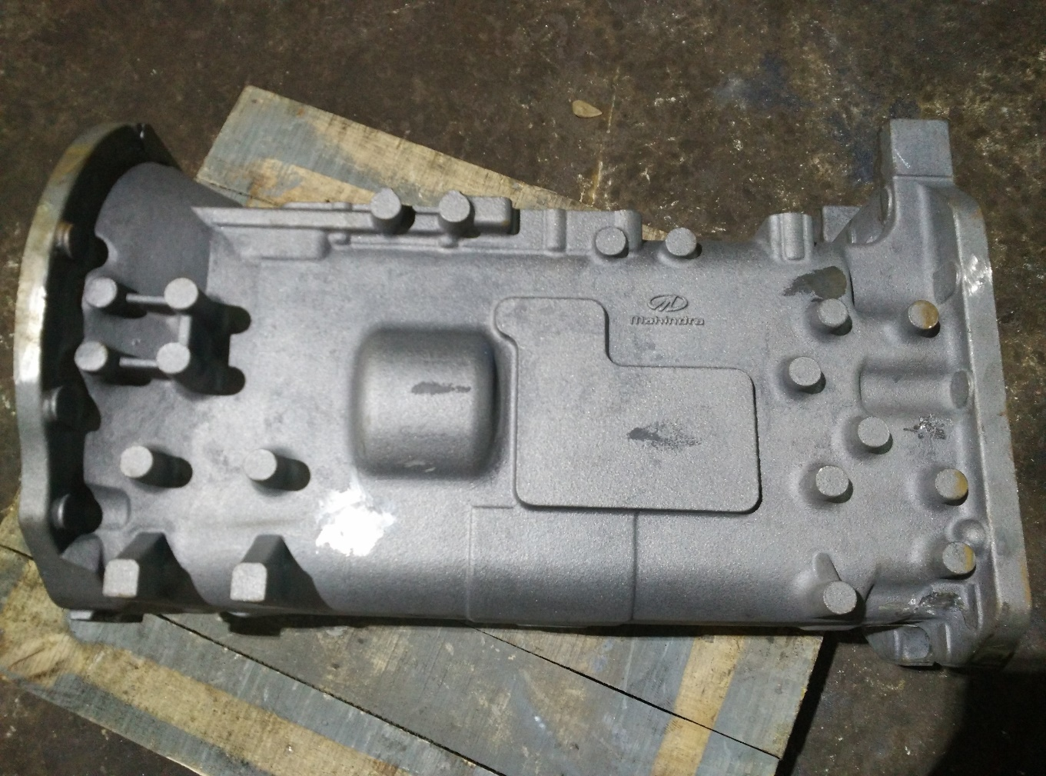
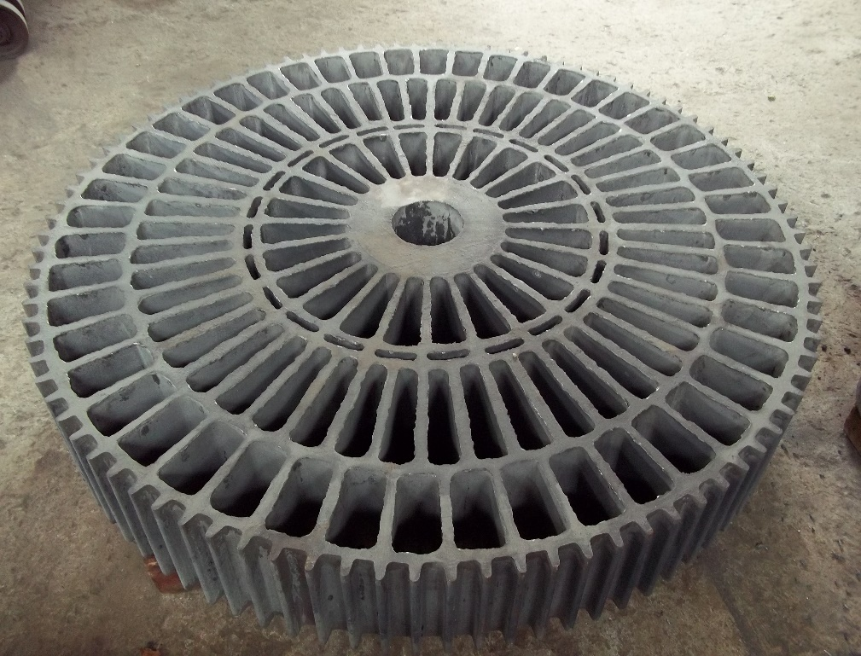
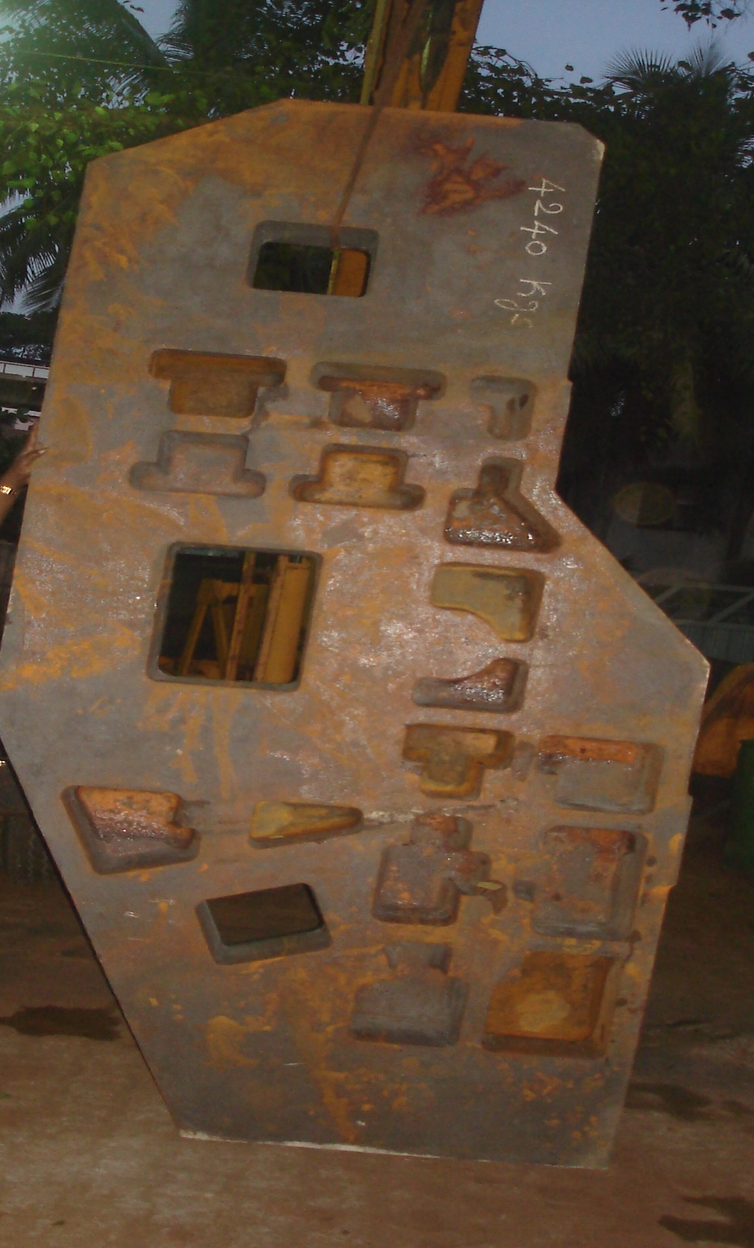
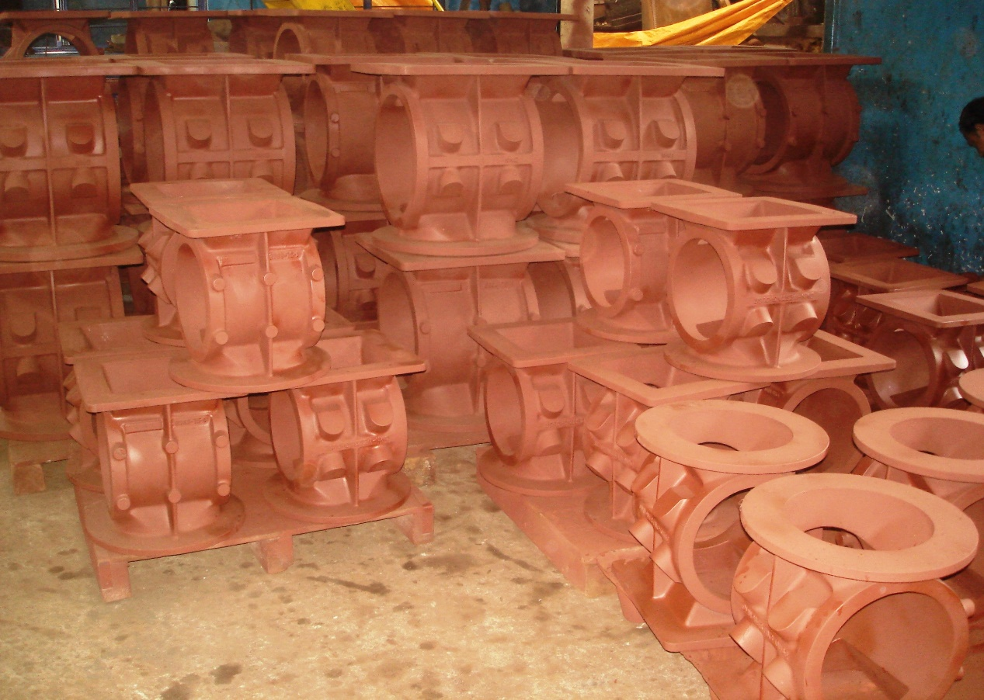
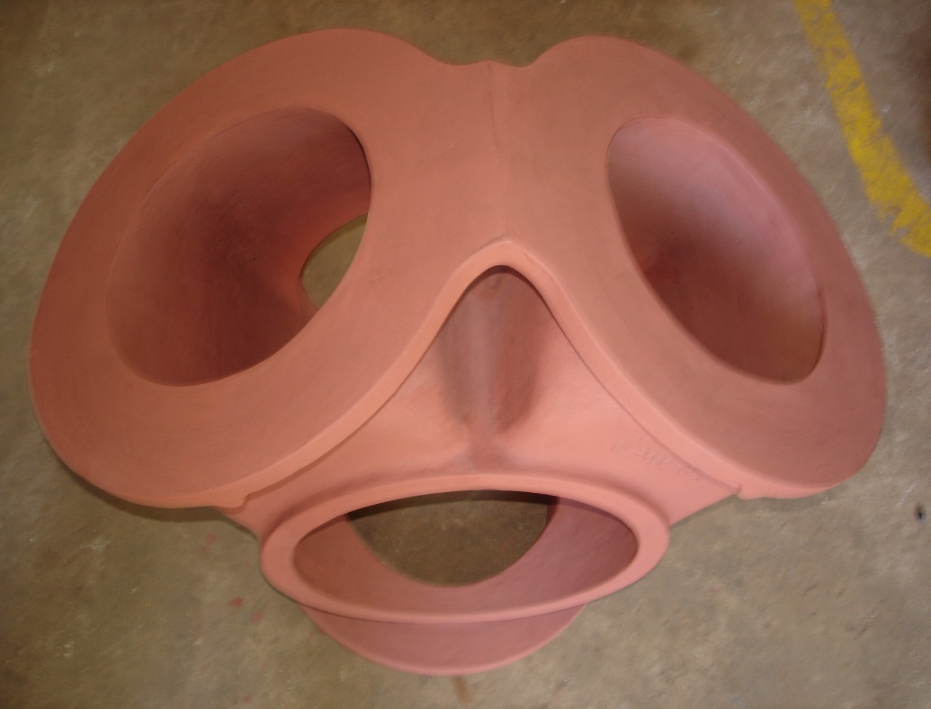
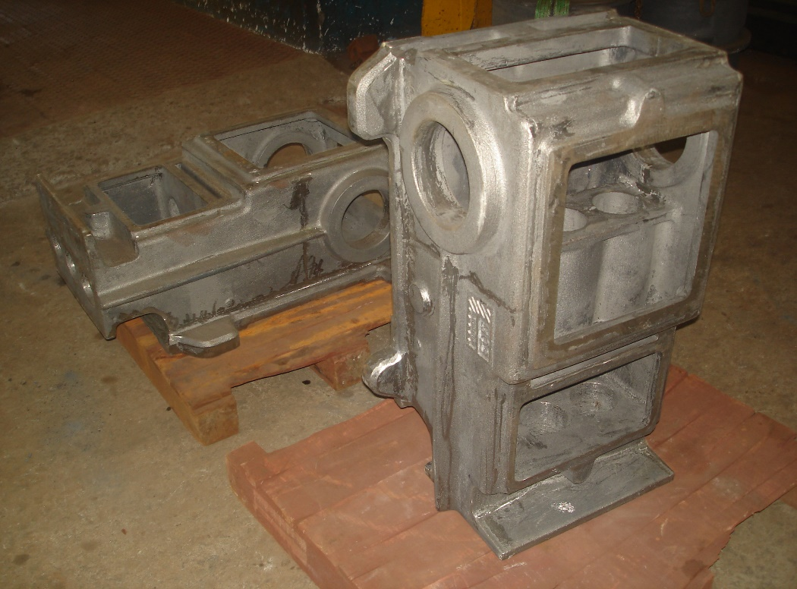
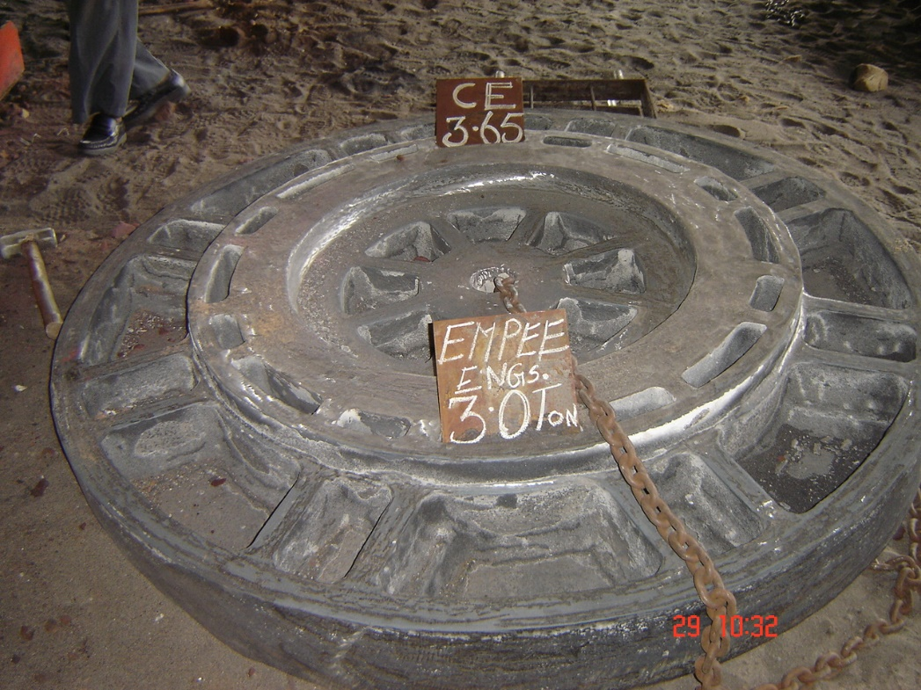
Castings Wall
Continued

Slide 19
Outsourced services
Continued
Pattern manufacture
Wooden Patterns
Metal Patterns
Polystyrene and Epoxy patterns
Machining
We have tie ups with competent facilities that offer a wide variety of CNC machining with CMM Inspection:
HMC VMC Turning machines
Radiographic Testing (RT)
Ultrasonic inspection (UT)
Magnetic Particle Inspection
Heat Treatment
Special Painting & coatings

Slide 20
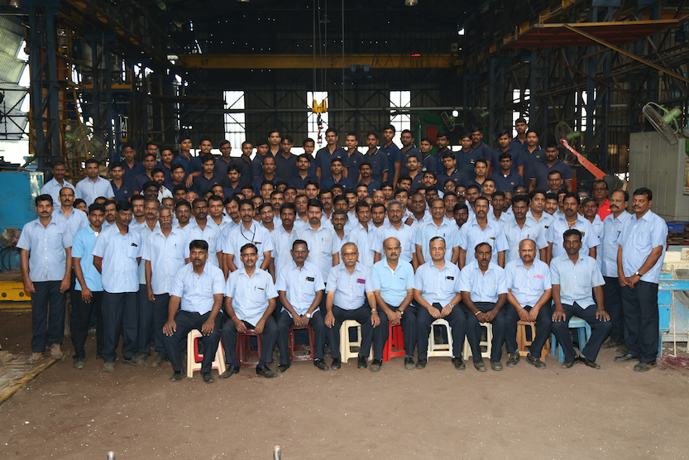
Human Resource
Work force of 85 people
with qualified managerial staff overseeing Production, Process Control, Inspection and Testing.
Team Akila

Slide 21

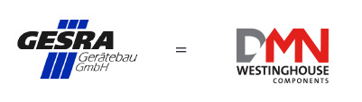


















Customers

Slide 22







Customers
AMITA

Slide 23
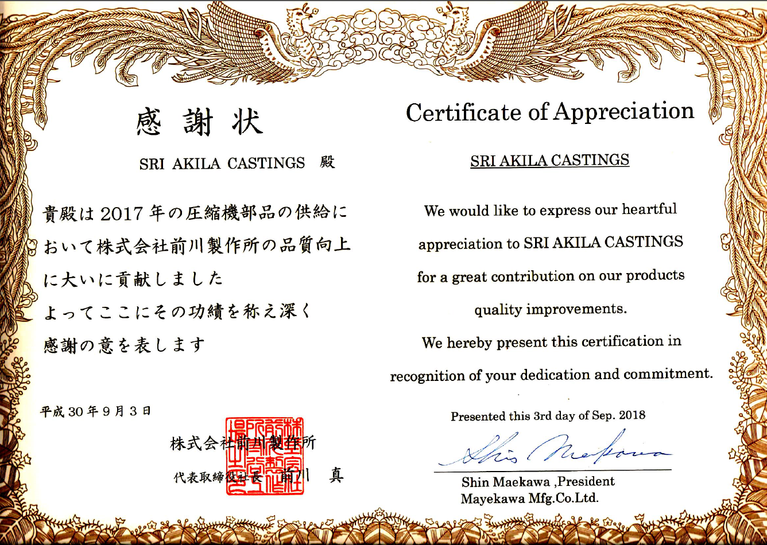
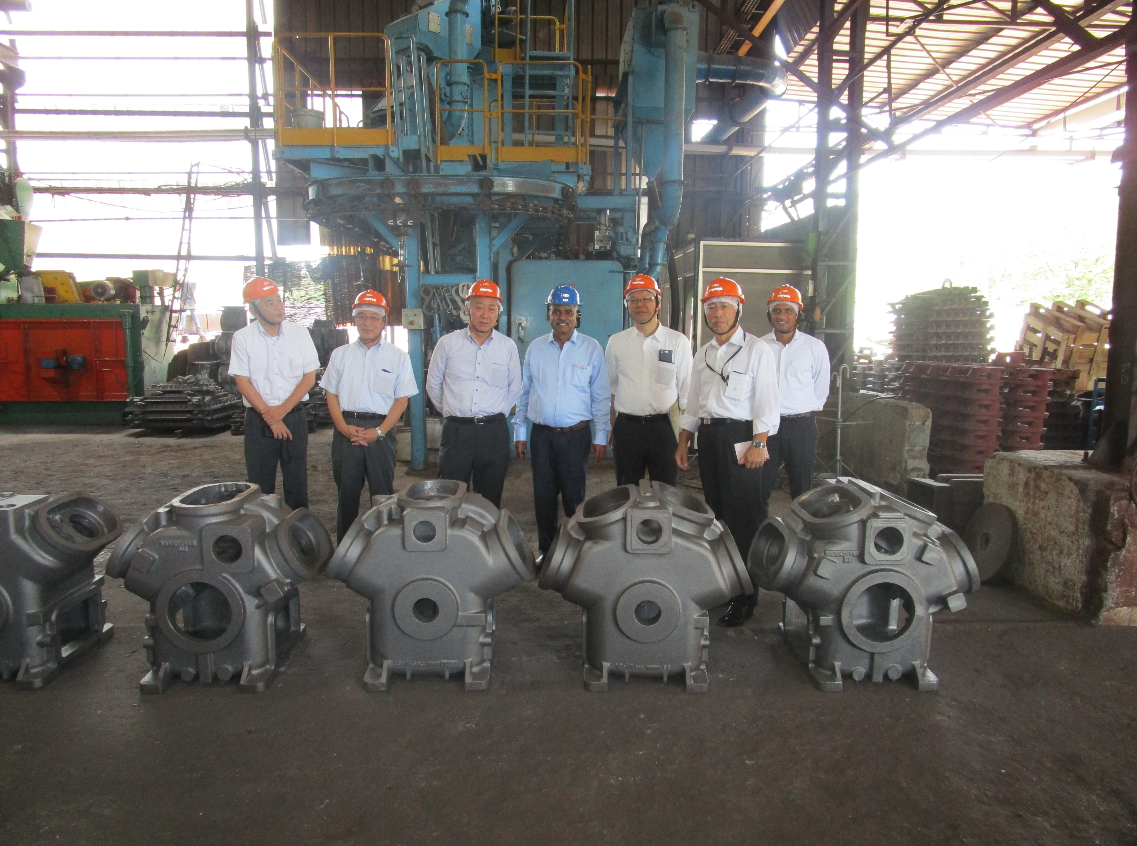
Customer appreciation

Slide 24
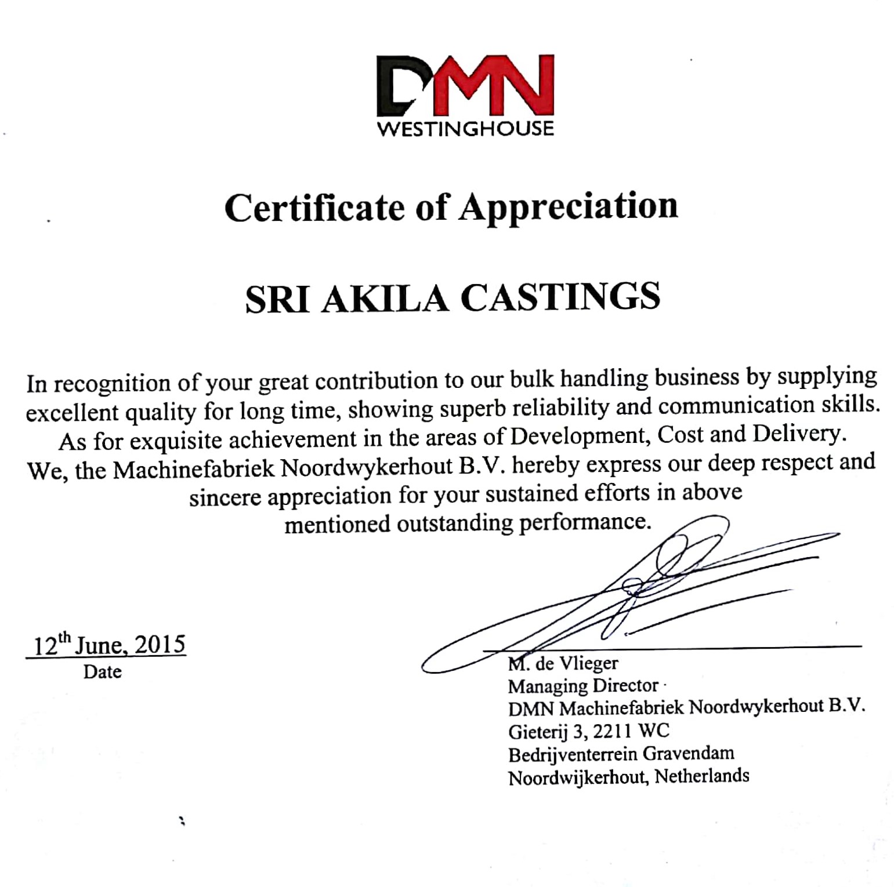
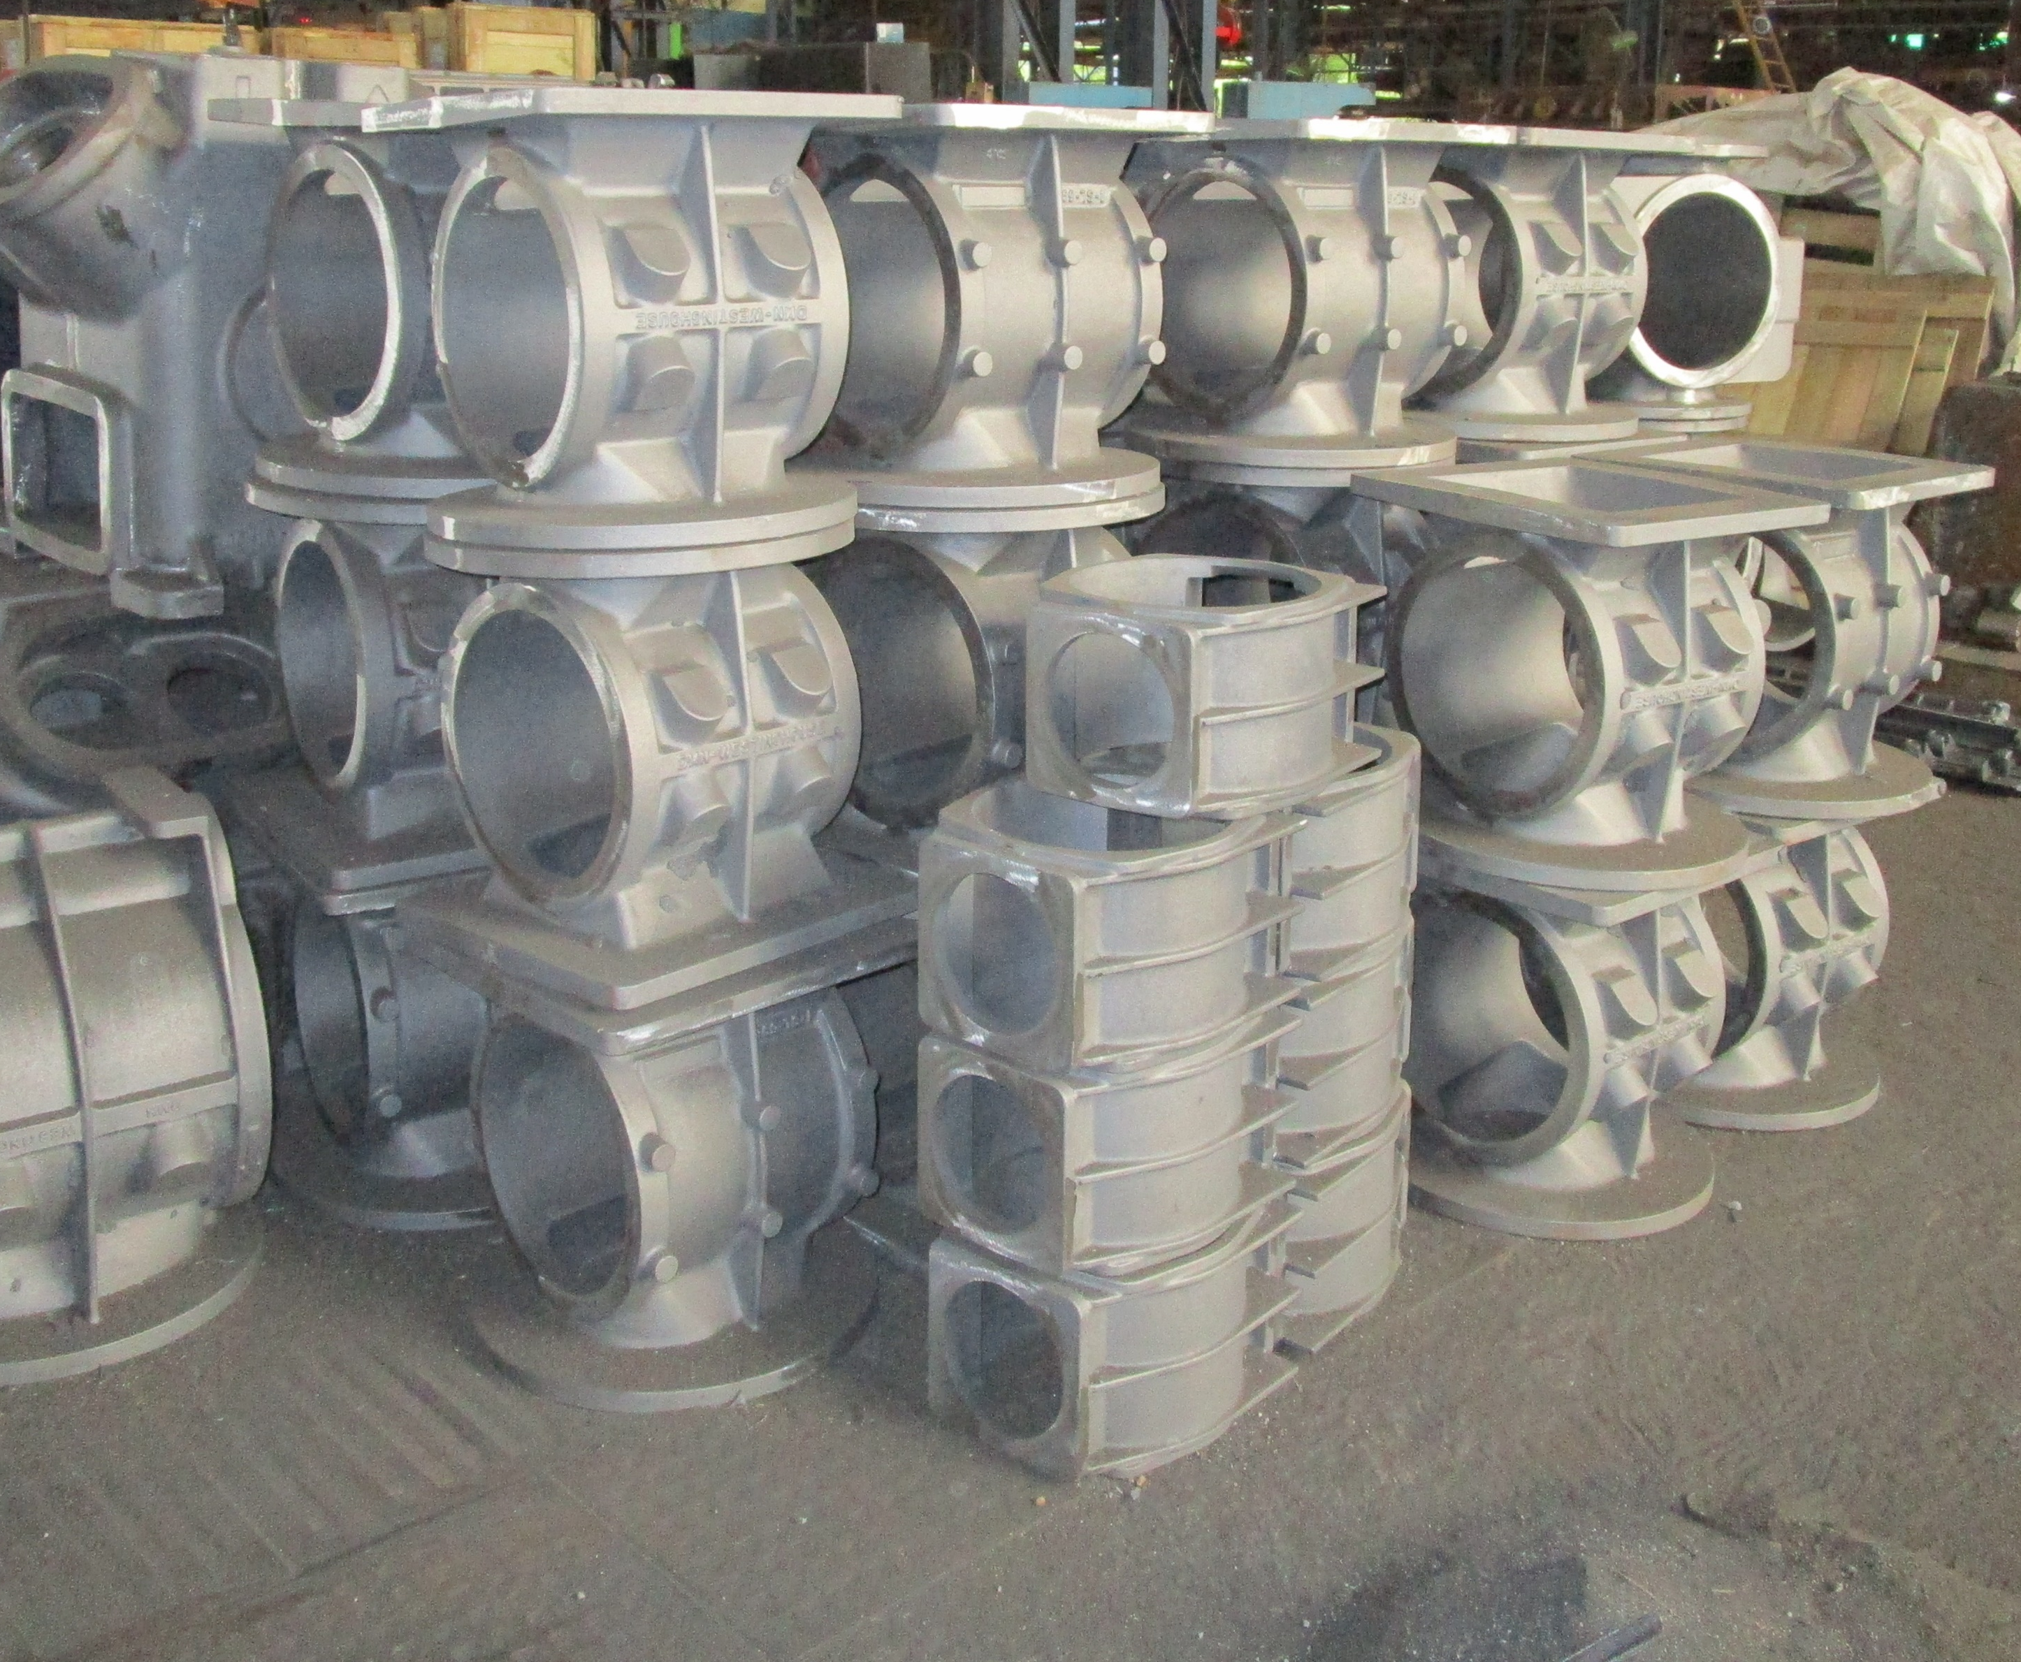
Customer appreciation

Slide 25


CONTACT US
SRI AKILA CASTINGS
Super B-4a, Thiru-Vi-Ka Industrial Estate
Guindy, Chennai – 600 032
Tamilnadu, INDIA
akila@akilacast.com
md@akilacastings.com
 91 44 22500167
Mr P.Vasanth Prabhu
CPO
0 98410 15310

Slide 26
Thank you!

